Slide 1

Copyright © 2026 Brisbane Catholic Education
This material has been copied and communicated to you in accordance with the statutory licence in section 113P of the Copyright Act 1968. Any further reproduction or communication of this material by you may be the subject of copyright protection under the Act.
Do not remove this notice.
This PowerPoint has been prepared by the Formation and Engagement Services, Brisbane Catholic Education.

Slide 2

Welcome

Slide 3
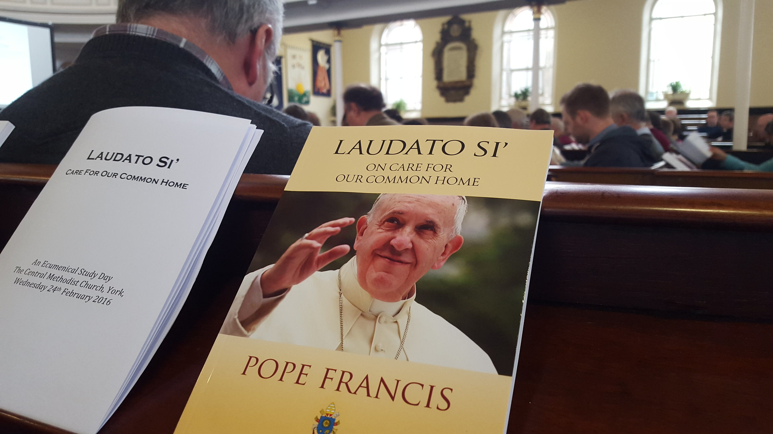
Reflection and Review
What Components/elements of the RLOS do we do well at my school? Why?
What Components/elements of the RLOS would I like to see developed further at my school? Why?
"Laudato Si' Study Day 24 02 2016 (49)" by gbcarmelite is licensed under CC BY 2.0.

Slide 4
Religious Identity of Catholic Schools
Has your definition of a Catholic school changed?
What is the bigger picture that Catholic schools sit within – what are the cultural forces that are impacting how we ‘be’ Catholic schools today?
What do schools need to do in order to stay faithful to our “Calling” as Catholic schools but recontextualized to this time and place?

Slide 5
Cathedral Visit and Mass

Slide 6
Cathedral Visit & Mass – Notice & Wonder
What did you see and hear?
What struck you?
What are your burning questions?
How could you use this in the Curriculum?

Slide 7
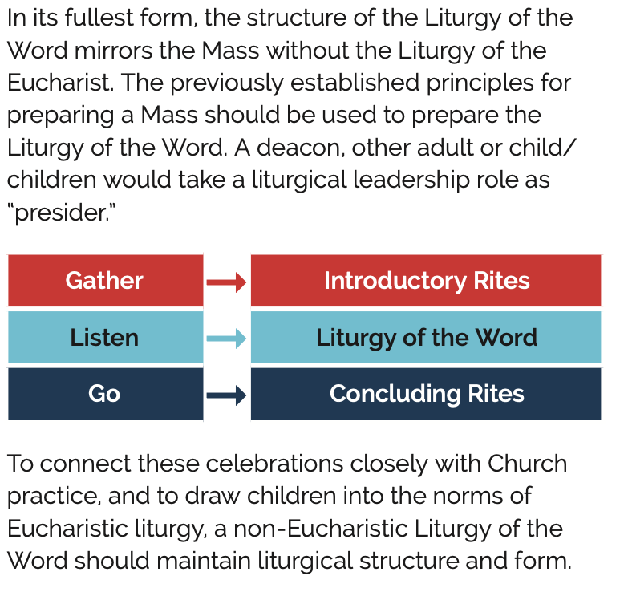
Non-Eucharistic Liturgies

Slide 8
Liturgy of the Word (Non-Eucharistic) Structure
Introductory Rites
• Gathering Song and Procession
• Sign of the Cross
• Presider’s Greeting and Statement of Purpose - “We gather today to celebrate ….(refer to Gospel message)”
• Penitential Act (optional)
• Collect (Opening Prayer)

Slide 9
Liturgy of the Word (Non-Eucharistic) Structure
Liturgy of the Word (Use the Children’s Lectionary in Primary School)​
• First Reading​ – Old or New Testament​
• Responsorial Psalm (if there is a First Reading) – preferably sung​
•​ Gospel Acclamation (sung)​
•​ Gospel​
•​ Homily/Reflection (even if a priest or deacon is not present, the Scripture​
message should be broken open for the children by another adult.)​
• Song or Ritual Action (optional) responding to the Gospel & Homily. This would​ be an appropriate place to include a rite of blessing or commissioning.​
• Prayer of the Faithful​

Slide 10
Liturgy of the Word (Non-Eucharistic) Structure
Concluding Rites​
•​ Lord’s Prayer (optional)​
•​ Sign of Peace (optional)​
•​ Blessing​
•​ Dismissal​
•​ Sending Song (optional but usually included)​
​

Slide 11
Universal Prayers
The Prayer of the Faithful makes a personal connection between the Liturgy and the daily life of Christians.
The petitions should be relevant to the needs and concerns of the people at this particular time, while also extending their compassion to include the whole world.
In these petitions the people make intercessions for all, with the result that, as the liturgy of the word has its full effects in them, they are better prepared to proceed to the liturgy of the Eucharist. #30 LMI

Slide 12
Universal Prayers
The Prayer of the Faithful takes the format of a short series of announced intentions, each followed by a period of silence during which the faithful make their prayer. Eg "For Pope Leo...that he may lead your people with integrity...Lord hear us. All respond: Lord hear our prayer.
The intentions should be brief, few in number, simply constructed and clearly articulated.
The series of intentions is usually to be:
a) for the needs of the Church;
b) for public authorities and the salvation of the whole world;
c) for those burdened by any kind of difficulty;
d) for the local community. #70 GIRM

Slide 13
Universal Prayers
Some key points:
We aren’t praying to change God’s mind, we are praying to expand our hearts.
Pray with the Saints
Miracles – particular needs – eg“...may they feel your loving care in the support that our community offers” rather than "please heal Joe of his illness"

Slide 14
  The Church’s Liturgical Year
  - Colour
  - Emphasis

Slide 15
A Resource for Learning about Liturgy and a resource for preparing a Liturgy

Slide 16
Together at One Altar
Access the site
Review the Explore – Craft – Receive – Live model of this site
How could you use this resource to help teach some of the Liturgy and Sacraments Content Descriptions that you have explored this morning?

Slide 17
Thank You

Slide 18
For more information
Formation and Engagement Services
FES@bne.catholic.edu.au

