Slide 1

Welcome

Slide 2
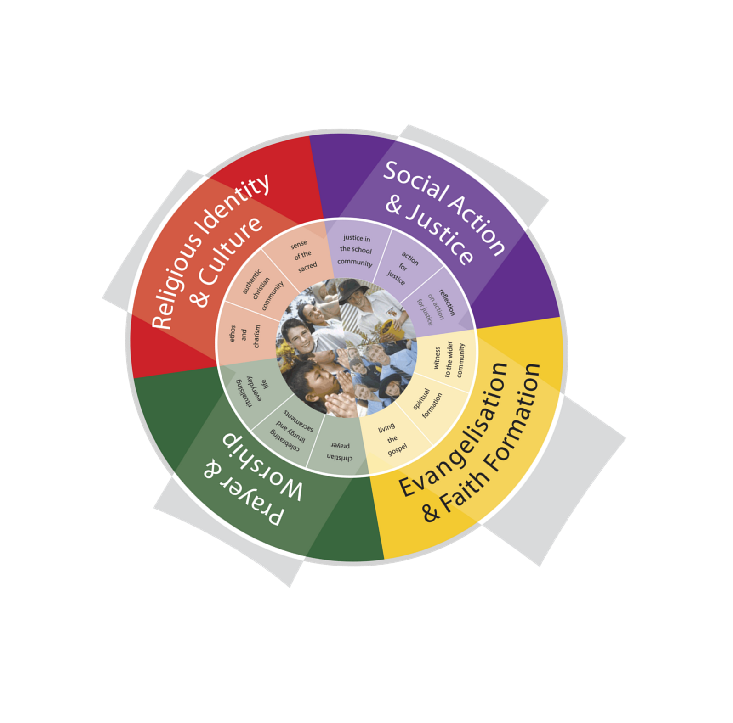
What are the Components of the RLOS?

Slide 3
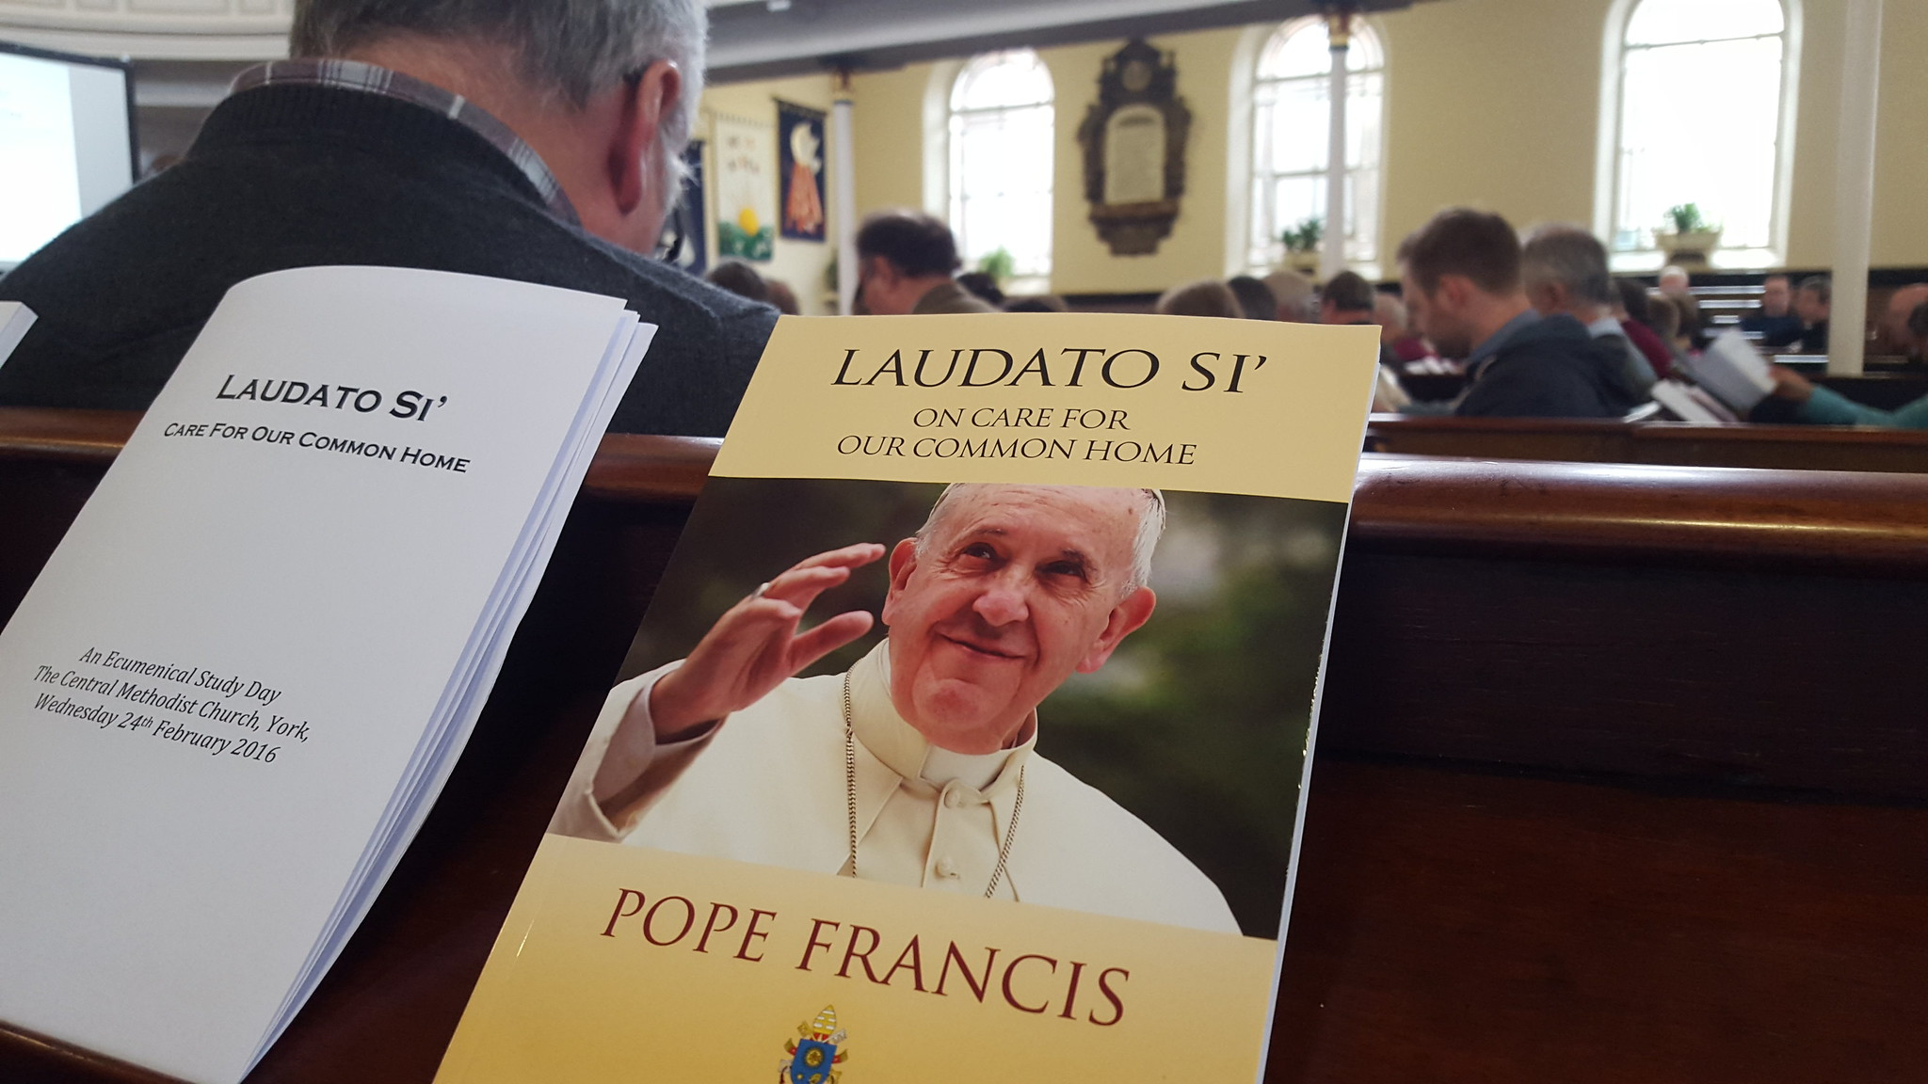
Reflection and Review
What Components/elements of the RLOS do we do well at my school? Why?
What Components/elements of the RLOS would I like to see developed further at my school? Why?
"Laudato Si' Study Day 24 02 2016 (49)" by gbcarmelite is licensed under CC BY 2.0.

Slide 4
Religious Identity of Catholic Schools
Has your definition of a Catholic school changed?
What is the bigger picture that Catholic schools sit within – what are the cultural forces that are impacting how we ‘be’ Catholic schools today?
What do schools need to do in order to stay faithful to our “Calling” as Catholic schools but recontextualized to this time and place?

Slide 5
The Religious Life of the School

Slide 6
Assignment 2
Due Date: Online Q & A:
Monday 18 May 2026 Monday, 20 April
Length: 2000 words
TASK
Using your school context, analyse the four components of the Religious Life of the School. Using your own school context, critically evaluate how each of the four components contributes to and enriches the Catholic Identity of your school. Further, identify the strengths and limitations of your school’s current expression of these components, and suggest opportunities to strengthen the religious life of the school within the identified context within your context.
Appendix: Prepare a prayer celebration or Liturgy of the Word for your school / class context for a particular liturgical celebration (e.g. Pentecost, School Feast Day, Ash Wednesday).

Slide 7
Suggested Approach
Identify and describe the each of the 4 Religious Life of the School components
Religious Identity and Culture
Prayer and Worship
Social Action and Justice
Evangelisation and Faith Formation
with reference to the Archdiocese of Brisbane Religious Education Curriculum P-12
(200-250 words)

Slide 8
Suggested Approach
Describe your own School Context
Provide a clear overview of the school, highlighting features that shape its religious identity, culture, and community.
(200–250 words)

Slide 9
Suggested Approach
Analyse Religious Identity and Culture
Explain how this component is expressed in the school and how it contributes to its religious identity. Link practices to Scripture, Church teaching, Catholic Social Teaching, Church (Church History) or Beliefs (Human Existence) strand in Archdiocese Religious Curriculum P-12 to show theological grounding.
Demonstrate how this component enriches spiritual formation and supports the school’s religious ethos.
Show critical insight by identifying strengths, gaps, opportunities for growth, and how this component collectively shape your school’s religious identity.
(350–450 words)

Slide 10
Suggested Approach
Analyse Prayer and Worship
Explain how this component is expressed in the school and how it contributes to its religious identity. Link practices to Scripture, Church teaching, Catholic Social Teaching or Christian Life (Prayer and Spirituality) strand to show theological grounding.
Demonstrate how this component enriches spiritual formation and supports the school’s religious ethos. Show critical insight by identifying strengths, gaps, opportunities for growth, and how this component collectively shapes your school’s religious identity.
(350–450 words)

Slide 11
Suggested Approach
Analyse Evangelisation and Faith Formation
Explain how this component is expressed in the school and how it contributes to its religious identity.
Link practices to Scripture, Church teaching, or Catholic Social Teaching to show theological grounding.
Demonstrate how this component enriches spiritual formation and supports the school’s religious ethos.
Show critical insight by identifying strengths, gaps, opportunities for growth, and how this component collectively shape your school’s religious identity.
(350–450 words)

Slide 12
Suggested Approach
Analyse Social Action and Justice (350–450 words)
Explain how this component is expressed in the school and how it contributes to its religious identity.
Link practices to Scripture, Church teaching, or Catholic Social Teaching or Christian Life (Moral Formation) strand in to show theological grounding.
Demonstrate how this component enriches spiritual formation and supports the school’s religious ethos.
Show critical insight by identifying strengths, gaps, opportunities for growth, and how this component collectively shape your school’s religious identity.

Slide 13
Suggested Approach
Prepare Prayer Celebration or Liturgy of the Word.
As an appendix, prepare a prayer celebration or Liturgy of the Word for your school / class context for a particular liturgical celebration (e.g.
Pentecost,
School Feast Day,
Ash Wednesday).
Make liturgical and theological connections to enhance the Catholic identity of your school.

Slide 14
Suggested Approach
Prepare Prayer Celebration or Liturgy of the Word (cont)
Include:
Introduction with theological understanding of the chosen liturgical celebration
Opening Prayer
Scripture
Prayer of the Faithful
Closing Prayer

Slide 15
Hints
Take time to review the Writing Guide (page 16)
Use Quality Source material
Keep your task in perspective
Referencing – APA and provide at least 7 references.
Constructing Your Assignment
Australian Catholic University provides online support for the way an assignment should be structured.
Review the conditions, task sheet and success criteria for this assignment
Have a colleague proof-read your assignment
Submit your assignment as a Word document
Schedule your assignment writing

Slide 16
Assignment 2 Submission
Submit through iLearn:
Upload completed assignments to iLearn in
Microsoft Word document format. (not PDF)
Enrol in the iLearn sessions and you will get
the opportunity to upload.
BCE09955
CORE Assessment Submission: Assignment 2
Please complete form sent via email to register your interest in completing the assignments for CORE.
Assessment | iLearn Code | Online – Q & A Session | Due Dates - 6 weeks post-day 2
Assignment 2 | BCE09955 | Program 1 20 April 2026 | Program 1 18 May 2026
 |  | Program 2 1 June 2026 | Program 2 22 June 2026
 |  | Program 3 20 July | Program 3 10 August 2026
 |  | Program 4 19 October 2026 | Program 4 20 November 2026

Slide 17
Options for support
If you require assistance, there are a number of support structures we have in place to assist you:
Your APRE,
Your Principal,
the team at FES
Contact CORE@bne.catholic.edu.au

Slide 18
Online Sessions
Session Topic | Mode | Dates
Beliefs about God, Jesus, Holy Spirit and Biblical Themes of Covenant and Messiah | Online 2hr session 4pm – 6pm Accreditation Hours: AR | 9 April 2026 9 July 2026 22 September 2026
Groups of First Century Palestine and Judaism | Online 2hr session 4pm – 6pm Accreditation Hours: AR | 14 April 2026 14 July 2026 28 September 2026
Church Teaching about Scripture and the Gospel Writers | Online 2hr session 4pm – 6pm Accreditation Hours: AR | 22 April 2026 22 July 2026 8 October 2026
Church History in the Archdiocese of Brisbane and Sacraments of the Roman Catholic Church | Online 2hr session 4pm – 6pm Accreditation Hours: AR | 27 April 2026 29 July 2026 13 October 2026
Please enrol in each of the sessions below.

Slide 19
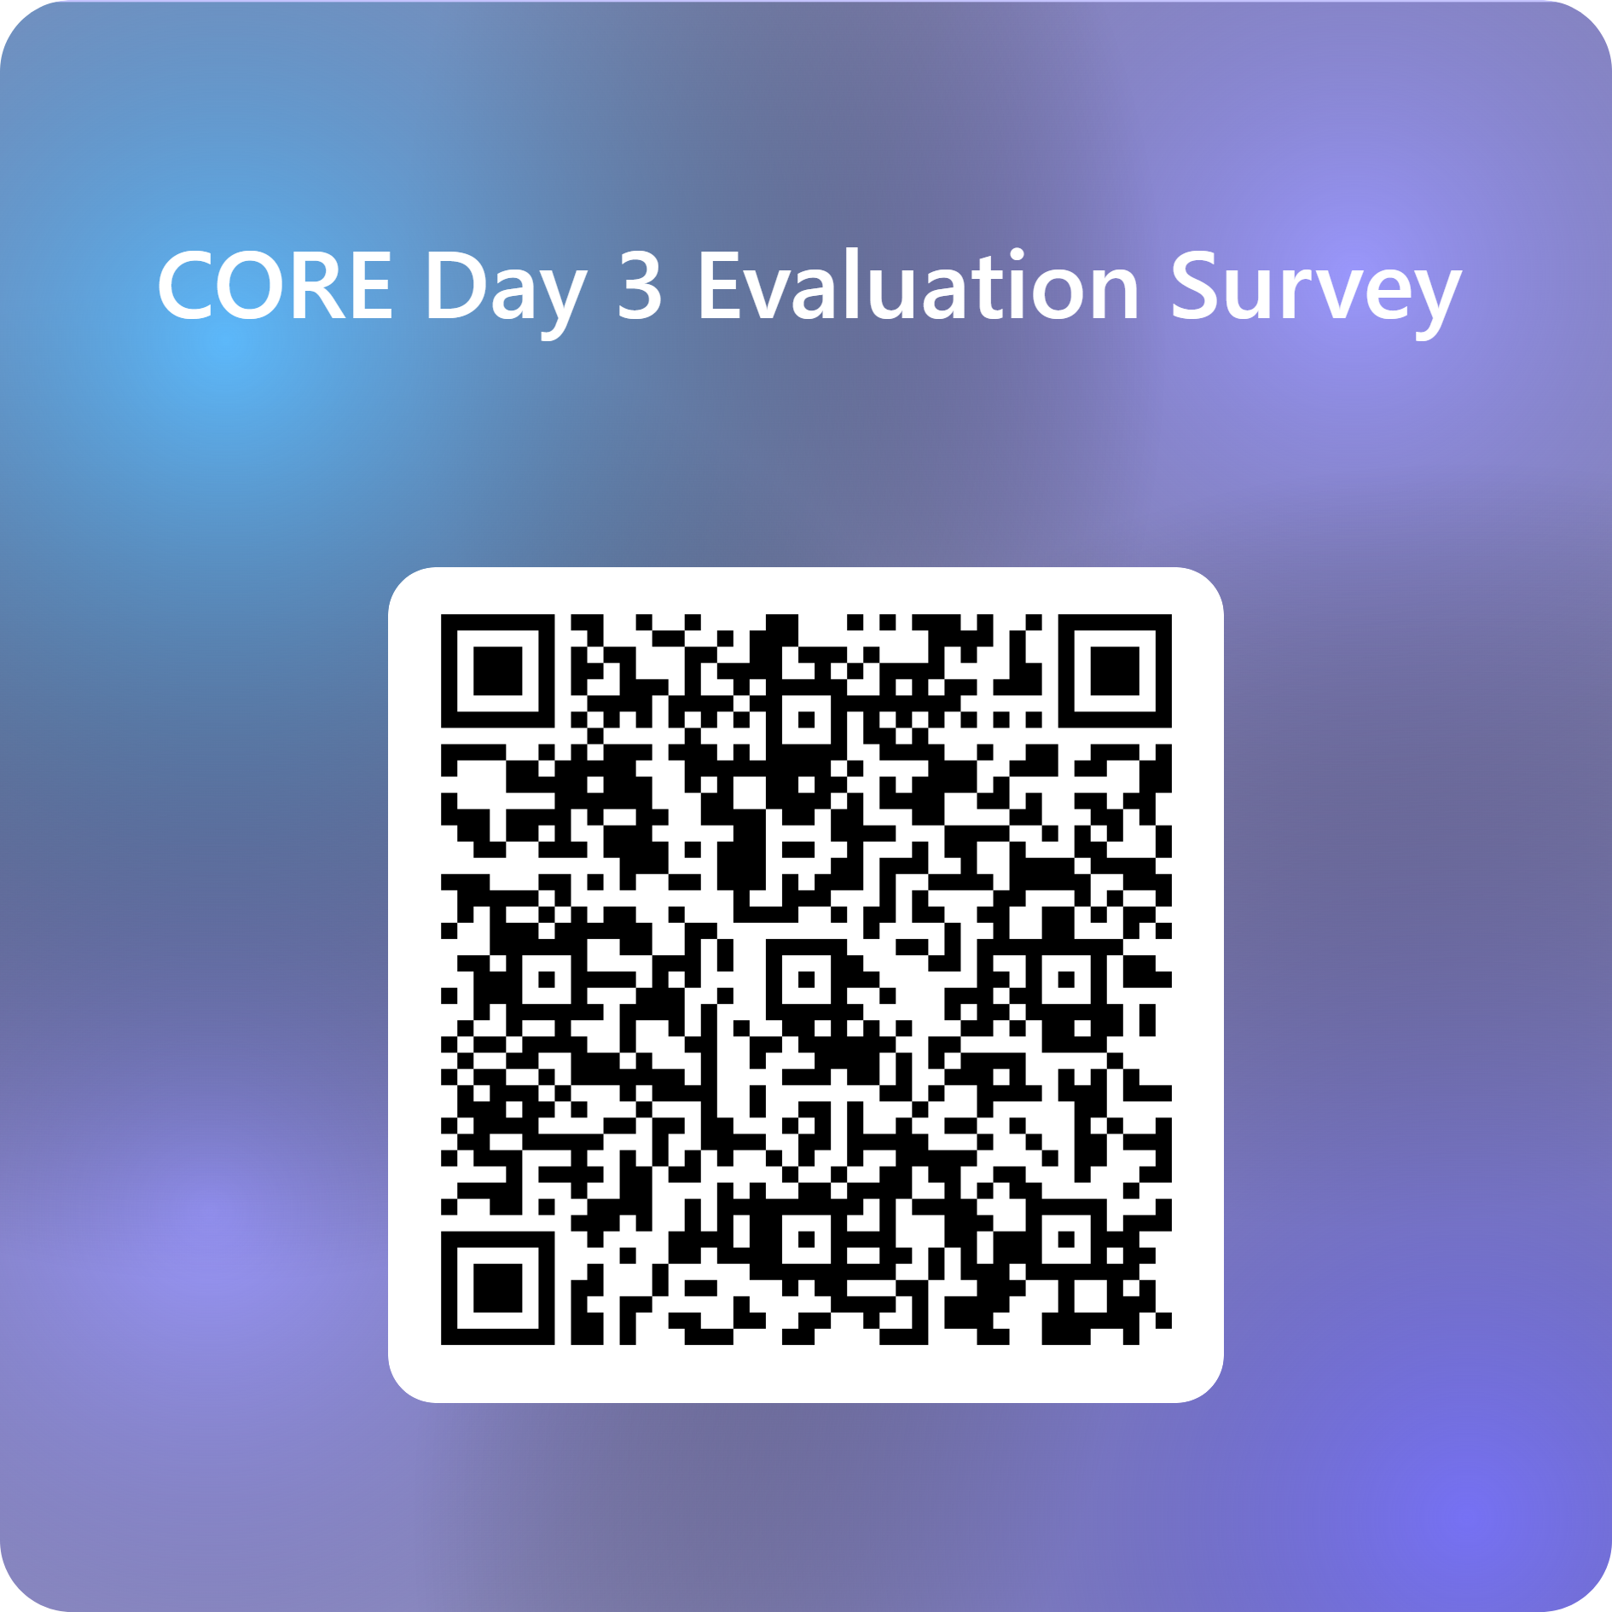
Feedback

Slide 20


Prayer
God of mission,
We thank You for these three days of formation.
Thank You for the people we’ve met,
the learning we’ve received,
and the renewed sense of purpose in our role as educators in Catholic schools.
Send us out now with courage and grace.
Help us to build schools where students feel safe, known, and loved.
Help us to be teachers who lead with compassion, integrity, and faith.
May we be instruments of Your peace, and witnesses of Your hope.
In the name of the Father, and of the Son, and of the Holy Spirit.
Amen.
We are a faith-filled learning community creating a better future
Notes:
Susie
God of mission,
we thank You for these three days of formation.
Thank You for the people we’ve met,
the learning we’ve received,
and the renewed sense of purpose in our role as educators in Catholic schools.
Send us out now with courage and grace.
Help us to build schools where students feel safe, known, and loved.
Help us to be teachers who lead with compassion, integrity, and faith.
May we be instruments of Your peace,
and witnesses of Your hope.
In the name of the Father, and of the Son, and of the Holy Spirit.
Amen.

Slide 21
For more information
Formation and Engagement Services
FES@bne.catholic.edu.au

