Slide 1

Copyright © 2026 Brisbane Catholic Education
This material has been copied and communicated to you in accordance with the statutory licence in section 113P of the Copyright Act 1968. Any further reproduction or communication of this material by you may be the subject of copyright protection under the Act.
Do not remove this notice.
This PowerPoint has been prepared by the Formation and Engagement Services, Brisbane Catholic Education.

Slide 2
Day 2 – Afternoon Session

Slide 3
Learning Outcomes
Learning Intention:
Building and clarifying understanding about assessment literacy
Identifying good practices around assessment in Religion

Slide 4
Assessment Literacy

Slide 5
Let’s hear from you
Consider, current Assessment Practices in RE
What is working well?
What do you want to improve?
What challenges do you face?
Are they different to other learning areas?
What current practices or approaches do you use for other learning areas in the school regarding:
How do begin your planning?
When do you look at assessment?

Slide 6
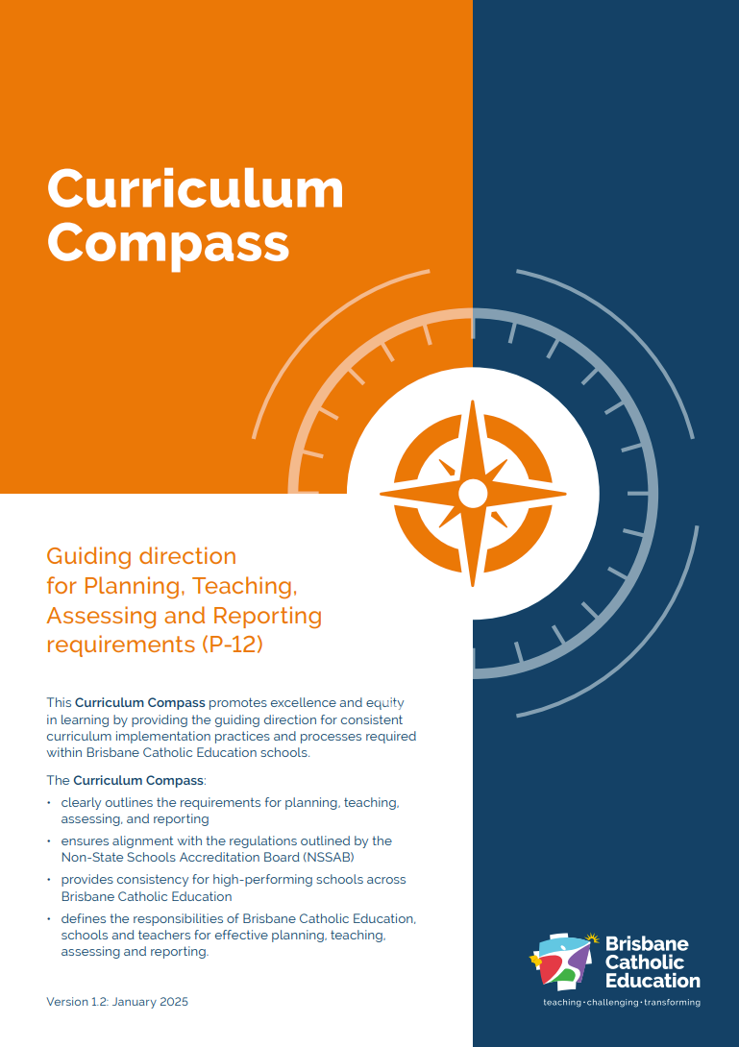
How do we develop good practices around assessment in RE?
Assessment:
improves teaching by providing information on what students know and can do
helps students progress in their learning by giving them feedback to inform their next steps in learning
provides meaningful information on students’ strengths, learning needs and achievements
Building and clarifying understanding about assessment literacy supports the processes integral to quality teaching, learning, assessment and reporting.
© Brisbane Catholic Education, Curriculum Compass Archdiocese of Brisbane (2024;2025 revised edition)

Slide 7
Principles of Quality Assessment
aligned
equitable
evidence-informed
ongoing
transparent
informative
© Brisbane Catholic Education, Curriculum Compass Archdiocese of Brisbane (2024;2025 revised edition)

Slide 8
Principles of Quality Assessment
valid
accessible
reliable
Teachers design and implement quality assessment that is:
© Brisbane Catholic Education, Curriculum Compass Archdiocese of Brisbane (2024;2025 revised edition)

Slide 9
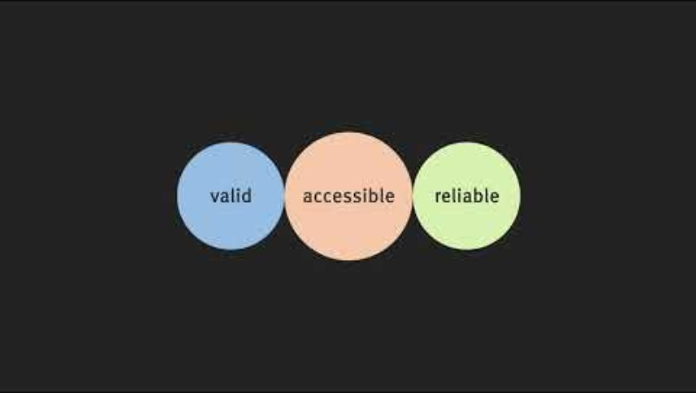
Assessment Literacy
Assessment Literacy, © State of Queensland (QCAA) 2019, licensed under CC BY 4.0

Slide 10
Assessment Attributes
Attribute | Definition | Considerations in RE
Validity | The extent to which an assessment accurately measures what it is intended to measure. | Align with RE Curriculum – based on Achievement Standard Authentic and appropriately challenging – cognitive load Provide realistic contexts
Accessibility | The extent to which the assessment provides all students with a clear understanding of how to demonstrate their learning. | Formative Tasks of a similar mode Provide effective feedback Consider access, equity and diversity Clear, appropriate use of layout, cues, visual design and format Instructions are clear, concise and unambiguous Opportunities for differentiation (where appropriate)
Reliability | The extent to which an assessment will produce the same consistent result. | Professional discussion of the descriptors prior to teaching Provide students opportunity to engage with achievement standard Professional moderation
Adapted from: https://www.qcaa.qld.edu.au/about/k-12-policies/student-assessment/understanding-assessment/attributes-quality-assessment

Slide 11
Being an Assessment Literate Teacher
Assessment-literate teachers:
have the skills and knowledge required to measure and support student learning through assessment (DeLuca et al., 2016)
interrogate the expectations of the curriculum and consider their students’ needs and interests before making assessment decisions
Cognitions and Pedagogy
Assessment Design
Religious Content
Learning Experiences

Slide 12
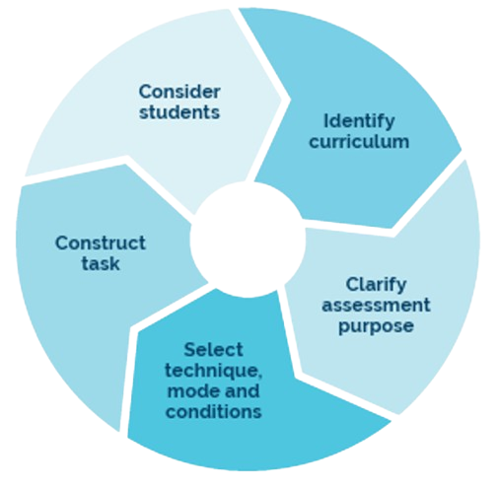
Being an Assessment Literate Teacher
Assessment literate teachers gather evidence of student progress to inform teaching and to make judgments about achievement.
Let’s apply this to RE
© Brisbane Catholic Education, Curriculum Compass Archdiocese of Brisbane (2024;2025 revised edition)

Slide 13
Consider students
Consider…. | Resources to Support
Who are my learners? What have they learnt? What are they ready to learn next? Why have they not yet learnt? What do they need to move forward? What am I noticing in my monitoring tools? What is important to know about where my learners are at in their developmental stages? (Spiritual, moral, physical, social emotional, cognitive) What are my students interested in? What student voice have I brought to the table? | Data Twice Yearly Reporting Monitoring Tools Student ENGAGE Profiles QCAA - Making assessment accessible Power BI

Slide 14
Identify the Curriculum
Consider…. | Resources to Support
What are my students learning? Identify what will be taught Achievement Standard Content Descriptions Skills identify what skills need to be unpacked Elaborations Cognitions What are they? Is explicit teaching required? Standards Elaborations | P-12 Religious Education Curriculum Year Level Overview Alignment of Achievement Standard to Content Descriptions Teacher Concept Maps Line of Sight Core and Complimentary Text Standards Elaborations

Slide 15
Clarify Assessment Purpose
Consider…. | Resources to Support
What is the assessment approach? include opportunities for demonstrating specific elements and multiple opportunities to demonstrate some elements of the achievement standard formative assessment, consider: how to monitor the teaching and learning progress how will you provide feedback summative assessment, consider: how tasks or specific monitoring strategies are used to assess different aspects of the standard how the task provides sufficient evidence of learning to make defensible and comparable judgments about the quality of student responses against the achievement standard | Designing Assessment in RE Curriculum Compass

Slide 16
Select technique, mode & conditions
Consider…. | Resources to Support
How will the evidence be collected? Technique: Are there multiple opportunities? Is there range and balance of assessment techniques? Mode: Are responses written, spoken/signed or multimodal? Do students have choice for their response mode (voice and agency)? Conditions: What are the requirements of the task: word length, e.g. 100 words time, e.g. perusal time, class time, own time. individual or group response ­ What equipment is required to support the task: access to and use of technology stimulus materials. | Designing Assessment in RE Curriculum Compass QCAA - Making assessment accessible

Slide 17
Construct Task
Consider…. | Resources to Support
Are the task details clear? Consider: clear instructions response required cognitive verbs or command terms accessible language ­ clear formatting and layout ­ accurate textual features, ie- grammar where to respond ­ resources to be used, ie- calculator organisation and placement of assessment items in the assessment task appropriate checkpoints to monitor progress and feedback | Designing Assessment in RE Curriculum Compass QCAA - Making assessment accessible

Slide 18
Moderation Process
Moderation is part of the planning, teaching + assessing process
Planning Phase | Teaching and Learning Phase | Making Judgements Phase
clarity of curriculum intent (cognitions) the evidence of learning that is to be collected through the learning cycle in alignment with the achievement standards the use of BCE RE standard elaborations as a tool to determine the extent of knowledge, understanding and skills that students will demonstrate (including collective understanding of qualifiers) | the learning opportunities required for students to develop and apply the agreed upon knowledge, understanding and skills across degrees of quality evidence of learning and assessment for / as / of learning and assess against the achievement standards | the agreed upon body of evidence against the BCE RE standard elaborations to assist in making judgements school processes and protocols to moderate student samples based upon agreed criteria that aligns with the achievement standards

Slide 19

Resources

Slide 20
Learning Outcomes
Learning Intention:
Building and clarifying understanding about assessment literacy
Identifying good practices around assessment in Religion

Slide 21
End of Day
Housekeeping and prep for Day 2

Slide 22
Online Sessions
Please enrol in each of the sessions below.
Session Topic | Mode | Dates
Beliefs about God, Jesus, Holy Spirit and Biblical Themes of Covenant and Messiah | Online 2hr session 4pm – 6pm Accreditation Hours: AR | 9 April 2026 9 July 2026 22 September 2026
Groups of First Century Palestine and Judaism | Online 2hr session 4pm – 6pm Accreditation Hours: AR | 14 April 2026 14 July 2026 28 September 2026
Church Teaching about Scripture and the Gospel Writers | Online 2hr session 4pm – 6pm Accreditation Hours: AR | 22 April 2026 22 July 2026 8 October 2026
Church History in the Archdiocese of Brisbane and Sacraments of the Roman Catholic Church | Online 2hr session 4pm – 6pm Accreditation Hours: AR | 27 April 2026 29 July 2026 13 October 2026

Slide 23
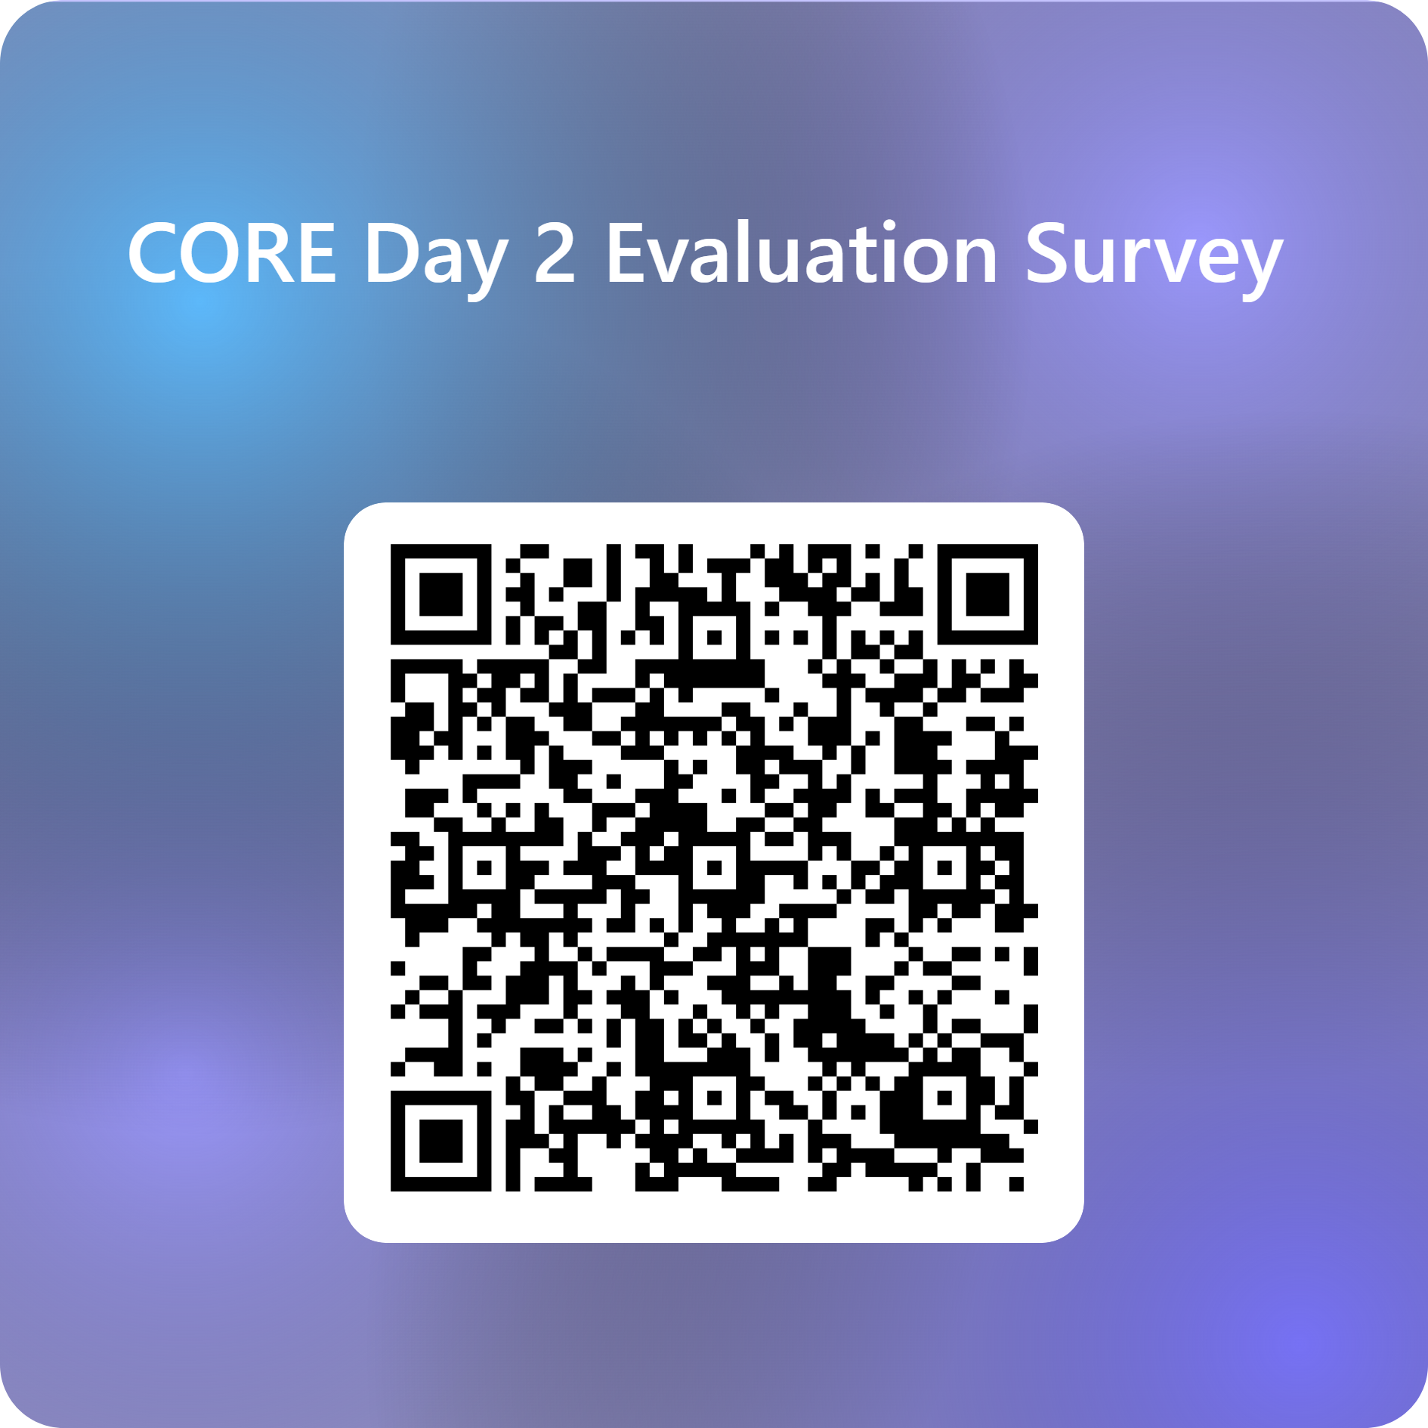
Feedback

Slide 24


Prayer
God of all goodness,
Thank You for the work of today
for the learning, the collaboration, and the skills we are building together.
Bless our planning and preparation,
so that what we design is not just compliant,
but meaningful, engaging, and faithful to the mission of Catholic education.
May we leave today encouraged and strengthened
ready to teach with confidence, ready to listen deeply,
and ready to lead students toward truth, wonder, and hope.
We ask this in Christ Jesus’ name.
Amen.
We are a faith-filled learning community creating a better future
Notes:
Susie
God of all goodness,
thank You for the work of today
for the learning, the collaboration, and the skills we are building together.
Bless our planning and preparation,
so that what we design is not just compliant,
but meaningful, engaging, and faithful to the mission of Catholic education.
May we leave today encouraged and strengthened
ready to teach with confidence,
ready to listen deeply,
and ready to lead students toward truth, wonder, and hope.
We ask this in Jesus’ name
Amen.

Slide 25
For more information
Formation and Engagement Services
FES@bne.catholic.edu.au

