Slide 1

Copyright © 2026 Brisbane Catholic Education
This material has been copied and communicated to you in accordance with the statutory licence in section 113P of the Copyright Act 1968. Any further reproduction or communication of this material by you may be the subject of copyright protection under the Act.
Do not remove this notice.
This PowerPoint has been prepared by the Formation and Engagement Services, Brisbane Catholic Education.

Slide 2

Catholic Identity Framework
Notes:
Strategic Directions:
Education Strategy:

Slide 3
Day 2 – Middle Session

Slide 4
Learning Outcomes
Deepen understanding of some pedagogical approaches used to teach Religious Education effectively

Slide 5

Model of Pedagogy
Model of Pedagogy, Curriculum Compass © Brisbane Catholic Education (2025).

Slide 6
Activate and Support
Activate multiple opportunities
Begin planning your learning experiences for your students
Consider how you will explicitly teach using the Gradual Release of Responsibility to scaffold and respond flexibly
Knowing your learners, what support might they need to progress?
Model of Pedagogy, Curriculum Compass © Brisbane Catholic Education (2025).

Slide 7
Activate and Support
Some pedagogical approaches used in Religious Education:
Inquiry learning
Explicit teaching
Questioning

Slide 8

Inquiry Learning in
Religious Education
"Light bulb drawing, black and" is marked with CC0 1.0.

Slide 9
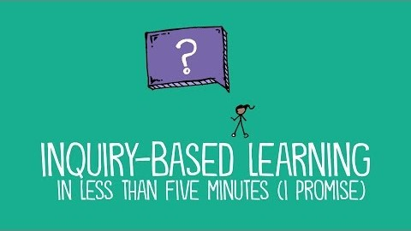
Notes:
Watch up until 1.42mins. Where do you see yourself? What does your teaching practice look like?

Slide 10
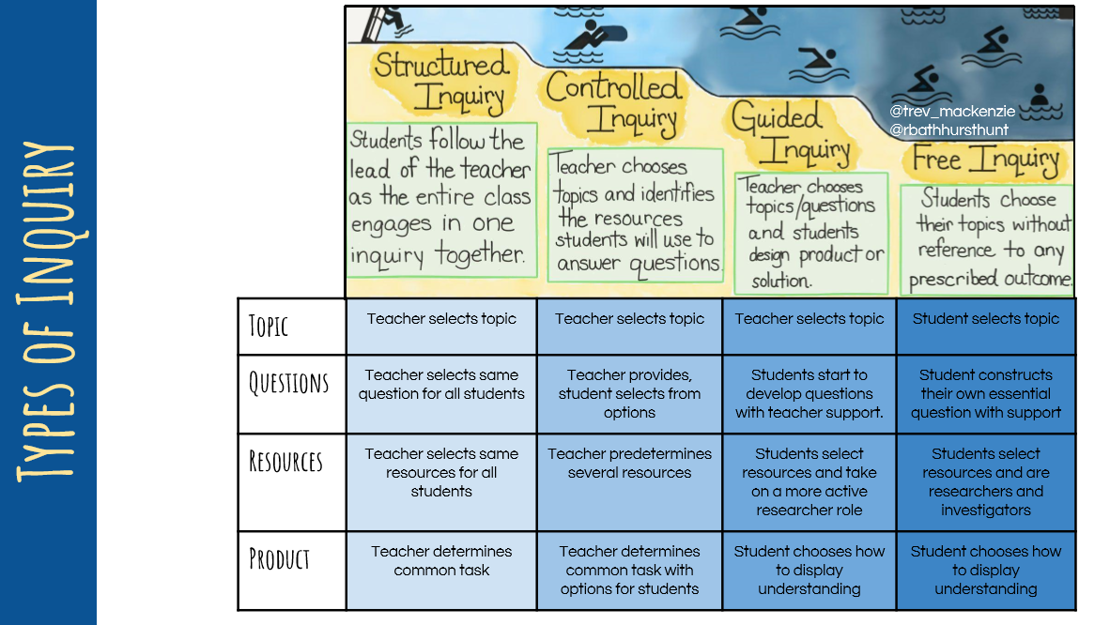
Notes:
Have you used any of these types of inquiry in your practice?

Slide 11
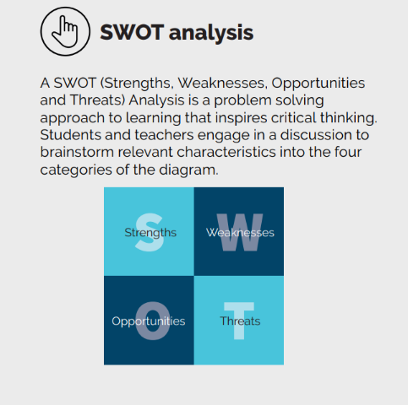
Activate and Support:
Inquiry Learning
Activity
In your table groups, complete a SWOT analysis of the inquiry learning approach.
Can you see this approach lending itself to particular aspects of Religious Education?
Elaboration and Organisation, Strategies that Maximise Impact © Brisbane Catholic Education (2025).

Slide 12

Questioning in
Religious Education
Use Questioning and Promote Discussion, High Impact Practices © Brisbane Catholic Education (2025).

Slide 13
Activate and Support:
Questioning
Conversations are one of the most powerful practices teachers
can use in classrooms to promote discussion and higher achievement
(Hammond & Hattie, 2020).
Questioning is powerful when it invites learners to think, not just recall, and when it is used to diagnose understanding rather than merely check for it
(Hattie, 2023).

Slide 14
Questioning in Religious Education
“Dialogue is a shared inquiry, a way of thinking and reflecting, in which the participants seek greater understanding of each other and the truth”​
George Kohlrieser​
The Power of Authentic Dialogue
Kohlrieser, G. (2006). The power of authentic dialogue. Leader to Leader, 2006(42), pp.36–40. doi:https://doi.org/10.1002/ltl.205.
Dialogue is born from a respectful attitude toward the other person, from a conviction that the other person has something good to say. ​
It supposes that we can make room in our heart for their point of view, their opinion and their proposals. ​
Dialogue entails a warm reception and not a pre-emptive condemnation. ​
To dialogue, one must know how to lower the defenses, to open the doors of one’s home and to offer warmth (Pope Francis, 2010).​

Slide 15
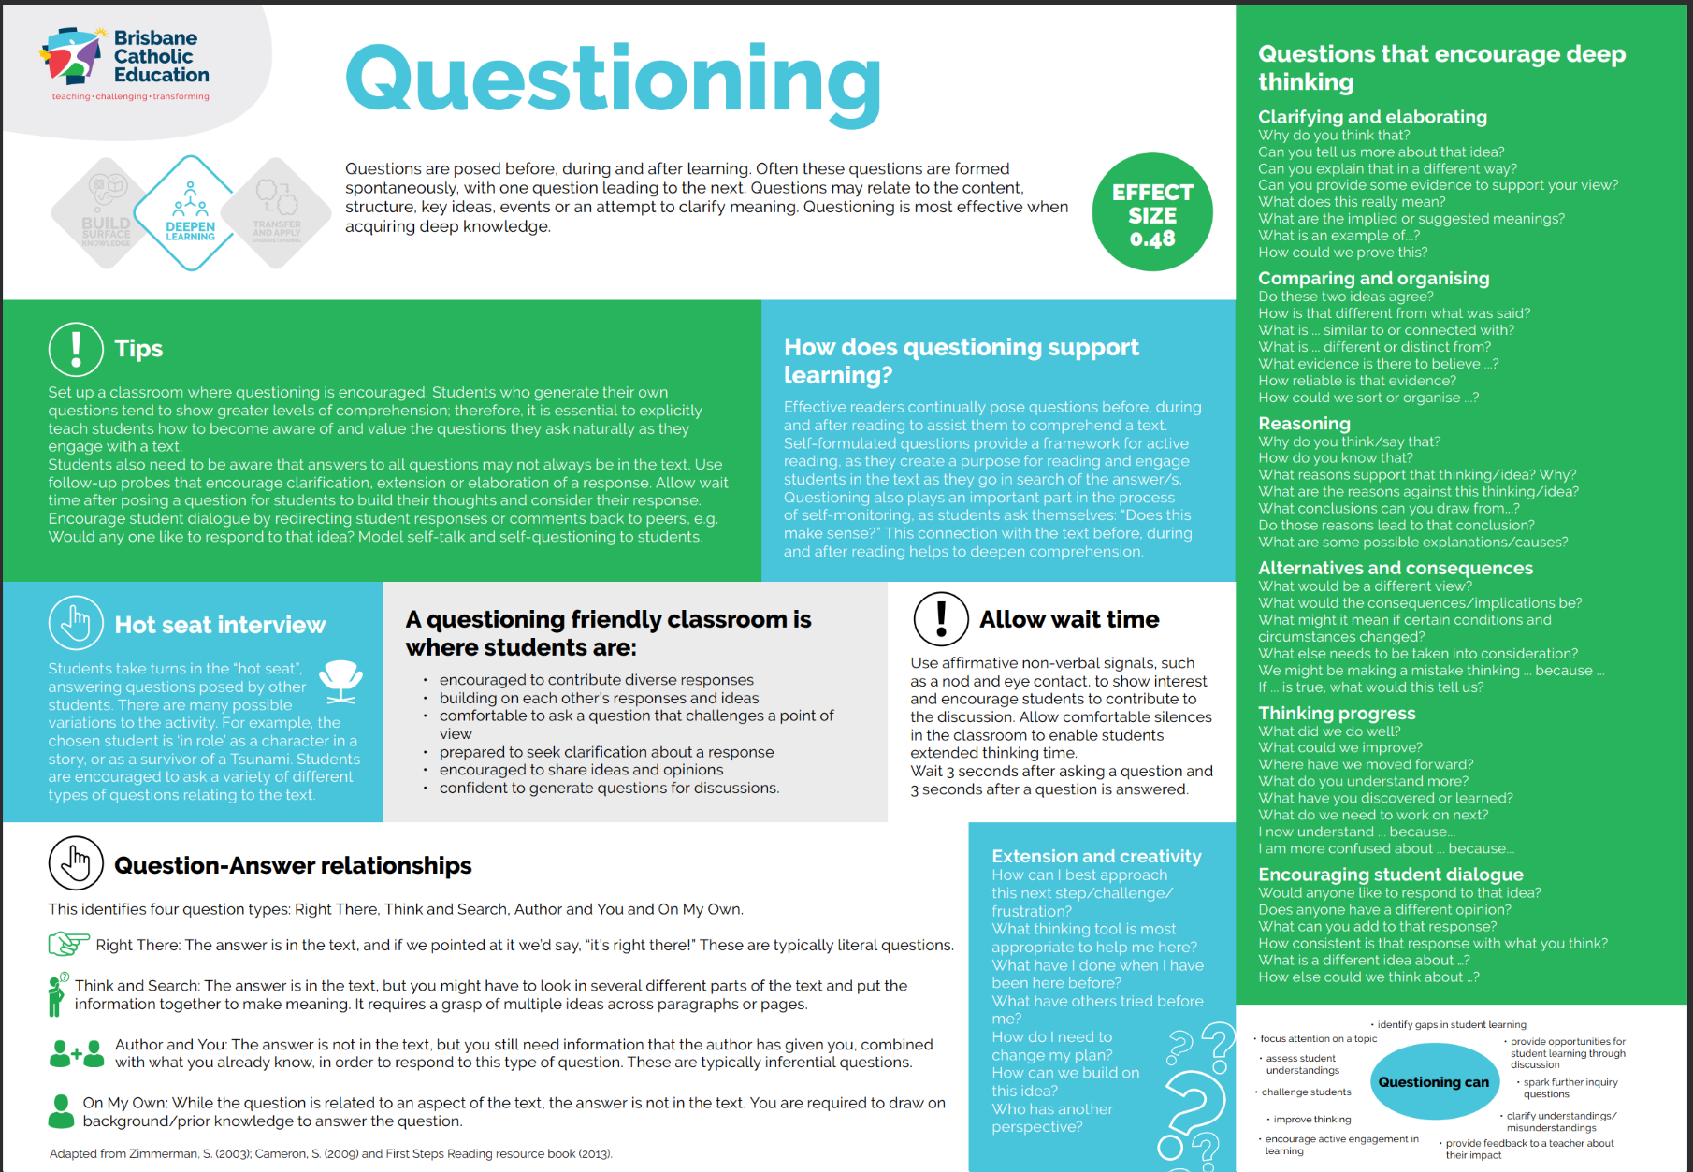
Activate and Support:
Questioning
Questioning, Strategies that Maximise Impact © Brisbane Catholic Education (2025).

Slide 16


Questioning Strategies
Class Discussion and Close Reading, Strategies that Maximise Impact © Brisbane Catholic Education (2025).

Slide 17
Questioning:
Generating Questions Strategy
Start with a stimulus​
Generate questions​
  Ask as many questions as they can​
  Don’t stop to discuss, evaluate or edit​
  Write down each question
  Change any statements into questions​
Improve questions​
  Categorise as opened or closed​
  Reframe​
  Consider the sequence​
Prioritise ​
  Choose questions for an inquiry​
Determine the next step​

Slide 18
The Forgiving Father
Read text: Luke 15:11-32
Know the text at an adult level (go to Michael Fallon msc or read through Into The Desert)
Know what the students need to learn about the text, at their level (go to the curriculum and determine what is it that the students actually need to know)
Know how to teach the text for student use and understanding (what pedagogical approach are you going to use)

Slide 19
Generating Questions Strategy
Start with a stimulus (such as a miracle or parable Scripture text)​
Generate questions​
  Ask as many questions as they can​
  Don’t stop to discuss, evaluate or edit​
  Write down each question
  Change any statements into questions​
Improve questions​
  Categorise as opened or closed​
  Reframe​
  Consider the sequence​
Prioritise ​
  Choose questions for an inquiry​
Determine the next step​
Notes:
First questioning strategy – students generating questions
Printed resource for more information: Question Formulation Technique (QFT).pdf

Slide 20
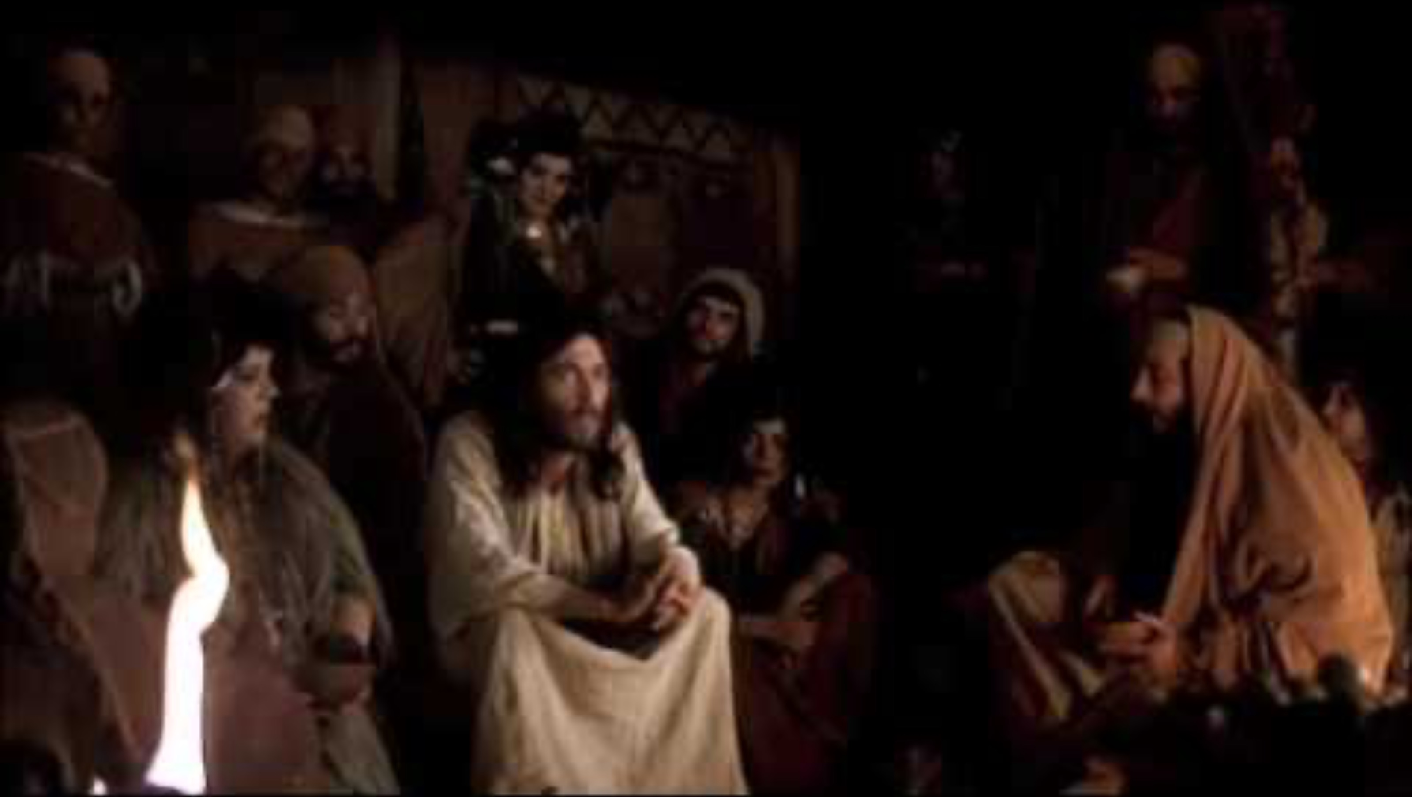

Slide 21
Generating Questions Strategy
Start with a stimulus (such as a miracle or parable Scripture text)​
Generate questions​
  Ask as many questions as they can​
  Don’t stop to discuss, evaluate or edit​
  Write down each question
  Change any statements into questions​
Improve questions​
  Categorise as opened or closed​
  Reframe​
  Consider the sequence​
Prioritise ​
  Choose questions for an inquiry​
Determine the next step​
Notes:
First questioning strategy – students generating questions
Printed resource for more information: Question Formulation Technique (QFT).pdf

Slide 22
Questioning:
Scripture Detectives Strategy
“Every writer couches his message in a certain genre in order to give the reader sufficient rules by which to decode that message. These hints guide the reader (or hearer) and provide clues for interpretation” (Osborne, 1991, p. 7)​
Engaging students as Scripture Detectives requires teachers to carefully construct good questions to investigate, including:
Questions to explore and wonder about the text
Questions for critical thinking about the text

Slide 23
Questioning:
Scripture Detectives Strategy
Some example questions:
Why did the author write this text? What does the author want people to understand about God?
We know this text was written thousands of years ago so is there anything we think the author would write differently today? Is there anything we need to critique about the image of God presented in this text?
How does the text tell us about God’s dream for our world?
In what ways do we help to bring about God’s dream for our world today?
What else could we do to help bring about God’s dream for our world today? (Actively seeking learner agency, creative and critical thinking.)
Why might people read this text today? (What meaning could they find to help them know how to live well in the world today?)
Imagine if everyone ignored the meaning we can find in this text. What might the world look like?

Slide 24
Questioning:
Interview Strategy
Break students into groups. Each member of the group takes on the role of one character in the text, the author or the interviewer.
Design interview questions to ask, aiming for questions that lead to discovery of deeper meaning from the text. Examples:
Author, can you tell us why you wrote about these characters? What did you want us to learn about them?
Can you describe what life was like for you as a woman in your time and culture?​
Tell us about your experience of…
How would you describe…?

Slide 25
What do students need to learn about the text?
As always, teachers need to be faithful to the curriculum and carefully plan the use of questioning to ensure it aligns with what students are expected to learn.
The Core and Complementary scripture texts document is an excellent support as it outlines the purpose for teaching the text and gives some sample questions that teachers can ask about the text.

Slide 26

Explicit Teaching in
Religious Education
Use Explicit Teaching, High Impact Practices © Brisbane Catholic Education (2025).

Slide 27
Activate and Support:
Explicit Teaching
"Explicit (teaching) is a systematic method of teaching
with emphasis on proceeding in small steps,
checking for learner understanding,
and achieving active and successful
participation by all learners."
(Archer, 2011)
BCE definition: The provision of clear, intentional instruction (explaining, demonstrating, modelling) that encompasses the craft of being responsive (the ability to make effective pedagogical decisions based on the learning context) (Growing and Thriving).

Slide 28
Activate and Support:
Explicit Teaching
Why: Learning is optimised for learners when it is delivered in a clear, organised sequence. When introducing new information, it is important to break things down and teach it explicitly. Using explanation, demonstration, and modelling helps learners grasp new concepts more confidently and thoroughly (AERO, 2024). It aligns with cognitive science principles by chunking content, activating prior knowledge, and using worked examples. This helps transfer learning into long-term memory (AERO, 2024).
Impact: Explicit teaching, where teachers clearly explain concepts, model skills, and guide practice, significantly improves learners learning outcomes, especially when combined with formative assessment and constructive feedback (OECD, 2025).

Slide 29
Teaching Scripture in Religious Education
Teaching Scripture requires teachers to:
Familiarise themselves with the Scripture before teaching it to understand it at an adult level
Ensure the interpretation reflects a contemporary Catholic worldview and theology (reconceptualist approach)
Make strong pedagogical decisions that support students to deepen their ability to interpret the text in multiple ways, and engage them in rich dialogue about the text
Provide opportunities for students to be challenged and transformed by the text, cognisant of the fact that the students in our schools will shape the future

Slide 30
A reminder…
Scripture Is Meant to Be Read Deeply
Scripture is not flat. It was never meant to be read only at the surface level. The four traditional lenses - literal, allegorical, moral, and eschatological - invite us to explore the richness of meaning embedded in the text.
This matters because when we teach miracles and parables, we’re not just helping students understand what happened - we’re guiding them to discover why it matters, what it asks of them, and how it points to something greater.

Slide 31
Teaching of scripture
Jigsaw activity
exploring the three sections of the RE Curriculum and Pope Benedict article where the teaching of scripture is outlined.
Person A - Teaching Scripture in the Classroom pp. 29 – 30
Person B - Sacred Texts pp. 37 – 38
Person C - Core and Complementary Scripture Texts: Appendix B pp. 238 – 239
Person D - Pope Benedict Article (link within CORE Resources Day 2)
Each member of the group is to read one section and teach the other group members about your section.

Slide 32
Jigsaw Activity
Step 1: Form Groups Participants work in groups of four. Each person in the group is allocated one section to become an “expert” in.
Step 2: Allocate Reading Sections Each group member is assigned one of the following: Person A: Teaching Scripture in the Classroom (pp. 29–30) Person B: Sacred Texts (pp. 37–38) Person C: Core and Complementary Scripture Texts: Appendix B (pp. 238–239) Person D: Pope Benedict Article (link located within CORE Resources – Day 2)
Step 3: Individual Reading and Reflection Read your allocated section carefully. As you read, consider: Key messages about the teaching of Scripture Language or concepts that stand out Implications for classroom practice and school contexts
Step 4: Teach Your Group Take turns sharing your learning with the rest of your group. When it is your turn, briefly explain: The main ideas from your section Why these ideas are important for teaching Scripture in RE Any practical implications or questions that arise
Step 5: Group Synthesis As a group, discuss connections across the four sections. Identify common themes, affirmations, or challenges related to teaching Scripture in Religious Education.

Slide 33
The 3 “Knows” of teaching scripture…
Know the text at an adult level.
Know what the students need to learn about the text, at their level.
Know how to teach the text to and for the students’ use and understanding.
Notes:
Review the expectations of the teacher when teaching scripture. Explore each in more detail on next three slides.

Slide 34
The 3 “Knows” of teaching scripture…
Know the text at an adult level.
Read an authoritative translation of the text e.g.
NRSVCE
CEV
NAB-RE
(Hint. Use Bible Gateway to read different translations
in parallel)
Read reflections and commentaries on the text.
(N.B. Fr Michael Fallon msc has a very good online resource for this part: welcome Michael Fallon.com and BCE has commentaries for most core texts.

Slide 35
The 3 “Knows” of teaching scripture…
Know what the students need to learn about
the text, at their level. Refer to the:
Achievement Standards
Content Descriptions
Core & Complementary Texts
What do these say the students need to know and be able to do?
Notes:
Refer back to Slide 31 – what does the achievement standard and content descriptor ask of students? What are the purposes of teaching the core texts?

Slide 36
The 3 “Knows” of teaching scripture…
Know how to teach the text for
student use and understanding.
What are some resources, pedagogies and
learning experiences that can be used to teach
this text effectively?
HIP Strategies
Strategies That Maximise Impact.pdf

Slide 37

The Three Worlds of the Text

Slide 38
The Good Samaritan
Prep: Students recognise Jesus’ teachings about love, compassion and forgiveness that challenged people about the way they were living. They relate examples of people having the freedom to choose between good and bad, right and wrong.
Year 4: investigate experiences of different communities including the Jewish communities in first century Palestine,
Notes:
mercy" or "compassion," since it normally expresses positive feelings toward someone; the translation "pity" is not as good, since "pity" in English often implies looking down on someone less fortunate, feelings of superiority. Tell the story of the Good Samaritan. (cev says pity) NRSVCE ( mercy)
Luke 10:25-37
Matthew 15:32-26 NRSVCE (compassion). NABRE (pity)
NRSCVE – New Revised Standard Version Catholic Edition
NABRE – New American Bible Revised Edition
CEV – Contemporay English Version

Slide 39
Preparing to teach Scripture
Select the text that you will teach. Each year level has core texts that must be covered and these are outlined in the Core and Complementary Scripture document on the BCE curriculum page.
Use quality, theologically sound resources to unpack the text at an adult level. This includes:
BCE Three Worlds of the Text resources
Commentaries
  The Catholic Study Bible
  Bible Gateway is a free
Dr Dan White books
The Worlds of the Text poster
The Core and Complementary Scripture document
Consider:
What would I need to teach first to enable the students to engage with/and understand the text?
Features of the text to explicitly teach

Slide 40
Which translations of Scripture should be used?
​On Bible Gateway, the following are approved translations:
New Revised Standard Version Catholic Edition (NRSVCE)
New American Bible (NAB)
Contemporary English Version (CEV - used in the Lectionary for Masses with Children)
On Bible Gateway, the Complete Jewish Bible (CJB) can also be helpful for comparison / exploring how the text has been translated for Jewish audiences.
Children’s Bibles are not recommended because they do not always contain an accurate version of the text.

Slide 41
Review versions
NRSVCE, NABRE, CEV
Luke 10:25-37

Slide 42
Activate and Support:
Explicit Teaching
Activity
1. Select a Scripture text for your year level.
2. Locate the following information to support you in planning to teach this text:
Core and Complementary scripture texts document
Appropriate translation of your text using Bible Gateway (NRSVCE recommended)
BCE Three Worlds of the Text commentary (if available – if not, visit mbfallon.com to locate a commentary)
Relevant content descriptions that tell you what needs to be taught about this text
3. Note what you would need to explicitly teach students about this text.

Slide 43

Questions
© Microsoft 365 content library, 2025

Slide 44
Learning Outcomes
Deepen understanding of some pedagogical approaches used to teach Religious Education effectively

Slide 45

Afternoon Tea
© Microsoft 365 content library, 2025​

Slide 46
For more information
Formation and Engagement Services
FES@bne.catholic.edu.au

