Slide 1

Copyright © 2026 Brisbane Catholic Education
This material has been copied and communicated to you in accordance with the statutory licence in section 113P of the Copyright Act 1968. Any further reproduction or communication of this material by you may be the subject of copyright protection under the Act.
Do not remove this notice.
This PowerPoint has been prepared by the Formation and Engagement Services, Brisbane Catholic Education.

Slide 2

Welcome

Slide 3

Acknowledgement of Country​
...knowledge grows through connection, that wisdom is shared through relationships, and that every learner brings their own story, identity, and gifts to the teaching and learning process.
...learning that is connected and relational, elevating explicit teaching, and making learning visible, which are all core to First Nations pedagogical practices.
...it was woven into community, culture, language and caring for Creation and Country.
...aligns deeply with Aboriginal and Torres Strait Islander models of pedagogy...
The classrooms are the land; the curriculum is this Country and pedagogy woven through stories, songs, movement, and lived experiences.
...cultural humility and respect, to strengthen our own practice by embracing holistic, culturally responsive ways of teaching that place the learner, their identity, and their connection to Country at the centre of learning.
...we pause to honour the First Nations peoples from all the Countries that make up our Diocese
...we pause to honour the First Nations peoples from all the Countries that make up our Diocese
May we honour Country not only in words, but in the way we teach, the way we listen, the way we learn and the way we shape the future for the young people entrusted to our care.
...knowledge grounded in deep listening, relationship, and responsibility.
...living, breathing part of how we understand learning itself.
We are a faith-filled learning community creating a better future
Notes:
Susie:
Today, as we gather in community for Day 1 of CORE:
*Click* we pause to honour the First Nations peoples from all the Countries that make up our Diocese — from the lands of the Turrbal and Yuggera peoples in Magandjin, the Yugambeh, Munangarli, Quandamooka, Jinibara, Urapul, Juggerapul, Kabi Kabi, Gubbi Gubbi, Wakka Wakka, Bundjalung, Jiabul, Githabul, Butchula, and Gooreng Gooreng peoples, and every Aboriginal Custodian of Country, whose stories, languages, cultures and spiritualities continue to shape these regions.
We acknowledge First Nations peoples ancient and enduring connections to land, waterways, seas, skies, and all living things. We pay respect to Elders past and present and all Aboriginal and Torres Strait Islander communities within our diocese who have carried knowledge across countless generations ...
*DOUBLE Click* knowledge grounded in deep listening, relationship, and responsibility.
For more than 80,000 years, First Nations peoples have been teachers within this Country.
*Click* The classrooms are the land; the curriculum is this Country and pedagogy woven through stories, songs, movement, and lived experiences. Learning for First Nations peoples is not separate from life ...
*Click* it was woven into community, culture, language and caring for Creation and Country.
The Brisbane Catholic Education Model of Pedagogy and CORE Curriculum, with its focus on knowing the learner, connecting to their prior knowledge and engaging them through holistic, visible, explicit and responsive practices, …
*Click* aligns deeply with Aboriginal and Torres Strait Islander models of pedagogy that have guided teaching and learning on this continent for tens of thousands of years.
These First Nations pedagogies are not separate to the BCE Model of Pedagogy, rather they are embedded through the model by emphasising ...
*Click* learning that is connected and relational, elevating explicit teaching, and making learning visible, which are all core to First Nations pedagogical practices.
As educators, we recognise the strength and sophistication of these ways of teaching and learning. They remind us that …
*Click* knowledge grows through connection, that wisdom is shared through relationships, and that every learner brings their own story, identity, and gifts to the teaching and learning process.
Today, as we engage in our own professional learning, we commit ourselves to First Nations peoples with ...
*Click* cultural humility and respect, to strengthen our own practice by embracing holistic, culturally responsive ways of teaching that place the learner, their identity, and their connection to Country at the centre of learning. We also commit to ensuring that Aboriginal and Torres Strait Islander perspectives are not an addition to our teaching, but a ...
*Click* living, breathing part of how we understand learning itself.
*Click* May we honour Country not only in words, but in the way we teach, the way we listen, the way we learn and the way we shape the future for the young people entrusted to our care.

Slide 4
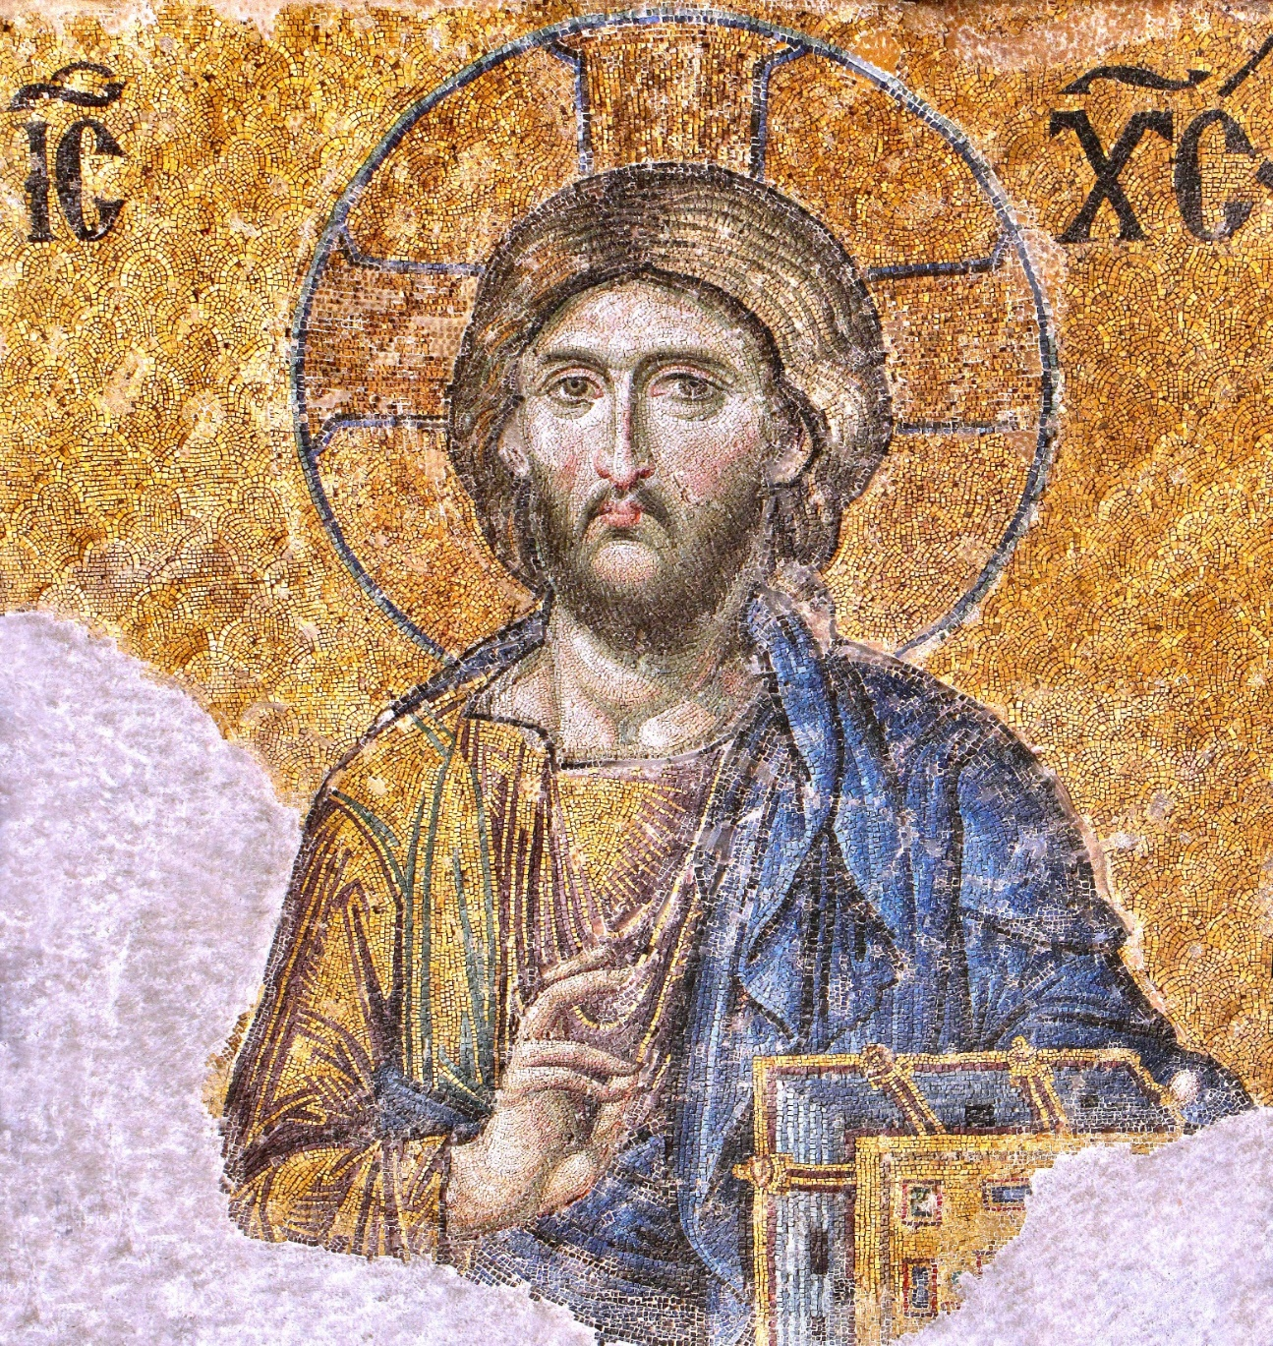
Dianelos Georgoudis / CC BY-SA
Called
to be
Teacher
Notes:
Invitation to prayer
PRAYER LEADER
Just as prayer is at the heart of our Catholic and Ecumenical schools, prayer will play a significant part in these 4 days of learning, questioning, interacting and visioning.
We each have different experiences, familiarity and comfort with prayer. We ask that you participate fully and enter into the prayer experiences with presence and reverence.
You will be given a variety of opportunities to pray with words and to pray without words; to reflect, to meditate, to listen, to sing and to experience times of silence and stillness. Copies of all these prayers will be made available to you and many of the ways we pray will be easily adapted for you to use to nurture your own prayer life and the prayer life of your students.
Over the next days, we hope there will be times when you will feel affirmed and inspired. There may be other moments when you will feel challenged and uncertain.
Above all we would hope that you come with a spirit of openness and willingness to grow and change in order to be empowered by the Spirit to teach with courage and faith.
Just as you have been called and chosen to BE a teacher, a religious educator, and a religious leader in your school community, you are called and chosen to make a commitment to this opportunity.
So let us prepare to ask God to be with us as we enter into this first day.
Lighting of the candle
Lights Down
PRAYER LEADER:
Preparing for Prayer
Many of us are thinking on full speed; we are thinking about what we have to do and what we haven’t done yet…..
Let us consciously put all this aside so that we can be present to the words and messages we will hear, the people we will interact with and the God who is with us.
Move your body back from contact with the table in front of you. Sit upright and place both your feet on the floor.... feel the floor.
Find a place for your hands to rest and close your eyes if this is comfortable for you.
Notice your breathing. Listen to your breathing.
Your breath is a very gift of life. God is present as you breathe in and as you breathe out. Breathe in who God is for you.
Put aside any worries or concerns, any frustrations or doubts, any busyness or pressures.
Let us put aside yesterday and the past
Let us put aside tomorrow and the future
Let us take a moment to be truly present to this moment in time and enter graciously into the spirit of the day.
Breathing for one minute .....

Slide 5
Sign of the Cross
Dianelos Georgoudis / CC BY-SA
Let us begin our prayer together
All: In the name of the Father and
of the Son and of the
Holy Spirit.
Amen.
Notes:
Sign of the Cross
PRAYER LEADER: Let us begin our prayer together
All: In the name of the Father and of the Son and of the Holy Spirit. Amen.

Slide 6
Dianelos Georgoudis / CC BY-SA
Opening Prayer:
Called to serve, teach and offer hope, open our minds to what we will hear.
All: Gracious God inspire us
Chosen to lead, inspire and act justly, open our ears to listen respectfully and to learn from Jesus the Teacher and the wisdom of others.
All: Gracious God teach us
Called and Chosen to come in hope, love and expectation, open our hearts to hold Your Spirit and share it joyfully.
All: Gracious God embrace us
Notes:
Opening Prayer:
READER ( same reader for each of these prayers)
Called to serve, teach and offer hope, open our minds to what we will hear.
Response: Gracious God be with us
READER
Chosen to lead, inspire and act justly, open our ears to listen respectfully and to learn from Jesus the Teacher and the wisdom of others.
Response: Gracious God be with us
READER
Called and Chosen to come in hope, love and expectation, open our hearts to hold Your Spirit and share it joyfully.
Response: Gracious God be with us

Slide 7
Dianelos Georgoudis / CC BY-SA
We Listen
Notes:
PRAYER LEADER
In the Gospels Jesus is often the teacher. He taught people about how to live, how to pray and how to hope. We read in Marks gospel that Jesus entered the synagogue and taught. They were astounded at his teaching, for he taught them as one having authority. They were amazed. The Gospels record times of explicit teaching but there were many times when Jesus taught by his actions and his presence.
Let us listen to the sacred words of Scripture.

Slide 8
Dianelos Georgoudis / CC BY-SA
A Reading from the Gospel according to Mark
(Mark1:21-22, 27-28, 35-39)
The Gospel of the Lord
All: Praise to you Lord Jesus Christ
Notes:
READER
A Reading from the Gospel according to Mark (1:21-22, 27-28, 35-39).
Jesus and his followers went to Capernaum; and when the sabbath came, Jesus entered the synagogue and taught. They were astounded at his teaching, for he taught them as one having authority, …
They were all amazed, and they kept on asking one another, “What is this? A new teaching—with authority! He commands even the unclean spirits, and they obey him.”
At once his fame began to spread throughout the surrounding region of Galilee.
In the morning, while it was still very dark, Jesus got up and went out to a deserted place, and there he prayed.
And Simon and his companions hunted for him. When they found him, they said to him, “Everyone is searching for you.”
He answered, “Let us go on to the neighbouring towns, so that I may proclaim the message there also; for that is what I came out to do.” And he went throughout Galilee, proclaiming the message in their synagogues and casting out demons.
The Gospel of the Lord
All: Praise to you Lord Jesus Christ

Slide 9
We Respond
Dianelos Georgoudis / CC BY-SA
Notes:
PRAYER LEADER:
Let us take time to contemplate the face of Christ and to pray with this Icon of Christ the Teacher.
The word icon is very popular today. We refer to clicking on the icon to open your e-mail or pop icons or cultural icons e.g. the Opera House. Religious Icons are also like quick links, in that they give us a kind of symbolic snapshot of holy persons who are in heaven. More than that, religious icons are a form of prayer. When you look at an icon, it is meant to make you aware that you are in the presence of God. Iconographers meditate before they create an icon and pray as they are painting or in correct terms, writing the icon.
Let us hold this image and pray.
Jesus is looking directly at the viewer, with his left hand holding the Sacred Word of God and his right hand is raised in blessing. Look closely at the right hand raised in blessing ...the thumb and 2 fingers represent the Trinity and the 2 other fingers symbolise the Divine and the human nature of Christ.
He is dressed in the traditional garb of tunic and cloak. The halo is a symbol of holiness and is inscribed with a cross and the Greek letters spelling "Who Am," the name used for God in Exodus.
The book is a symbol of his teaching ministry and the way he is the embodied Word of God.
The face of Jesus follows ancient traditions. The eyes are large and open, looking directly into the viewer’s soul. The forehead, identified as the seat of wisdom, is high and convex. The nose is long and slender, contributing a look of nobility. The mouth is small and closed in the silence of contemplation. The hair is curled and flowing, recalling the endless flow of time. The neck and body are powerful reminders of His strength and majesty.
We can do more with icons than just look at them or talk about them; we can pray with them. An icon is an invitation to prayer.
Notice the lines, the movement, the colours etc
Icons can show us the way; they invite us to follow a journey or engage in a pilgrimage.
Allow your eyes to journey around this entire image.
What do you see?
What can you hear?
What does this icon say to you?
What would be the word or message that Jesus has for you as a teacher in the 21st century?

Slide 10
Litany of Praise to Jesus the Teacher
Dianelos Georgoudis / CC BY-SA
Jesus, your disciples named you Teacher and Master
ALL: Holy Wisdom, we praise you
Jesus, you taught in fields, from hillsides and by the waters
ALL: Holy Wisdom, we praise you
Jesus, you taught through story and parable
ALL: Holy Wisdom, we praise you
Notes:
Litany of Praise to Jesus the Teacher
READER Jesus, your disciples named you Teacher and Master
ALL: Holy Wisdom, praise to you
READER Jesus, you taught in fields, from hillsides and by the waters
ALL: Holy Wisdom, praise to you
READER Jesus you taught through story and parable
ALL: Holy Wisdom we praise you

Slide 11
Litany of Praise to Jesus the Teacher
Dianelos Georgoudis / CC BY-SA
Jesus, you challenge our minds, hearts and spirits
ALL: Holy Wisdom, we praise you
Jesus, you taught with authority and compassion
ALL: Holy Wisdom, we praise you
Jesus, you are the Way the Truth and the Life.
ALL: Holy Wisdom, we praise you
Notes:
READER Jesus you challenge our minds, hearts and spirits
ALL: Holy Wisdom, we praise you
READER Jesus you taught with authority and compassion
ALL: Holy Wisdom, we praise you
READER Jesus you are the Way the Truth and the Life.
ALL: Holy Wisdom, we praise you

Slide 12
Sign of Peace
Dianelos Georgoudis / CC BY-SA
As people called to live and bring God’s peace to all, let us turn to each other and offer each other a sign of that peace we all seek.

Slide 13

Prayer
Loving Creator,​
You call us to share in Your wisdom and to nurture the gifts You have placed within each person.​
Today, we gather as educators and professionals, united in our mission to guide and inspire those entrusted to our care.​
Bless our minds with clarity, our hearts with compassion, and our hands with creativity.​
May the learning we share today strengthen our commitment to excellence and to teach, challenge and transform to create a better future. ​
Grant that our efforts reflect Your love and bring forth goodness
in our schools and communities.​
​
We ask this through Christ our Lord.
All: Amen
We are a faith-filled learning community creating a better future
Notes:
Loving Creator,
You call us to share in Your wisdom and to nurture the gifts You have placed within each person.
Today, we gather as educators, united in our mission to guide and inspire those entrusted to our care.
Bless our minds with clarity, our hearts with compassion, and our hands with creativity.
May the learning we share today strengthen our commitment to excellence and to teach, challenge and transform through our service.
Grant that our efforts reflect Your love and bring forth goodness in our schools and communities.
We ask this through Christ our Lord.
All: Amen.

Slide 14
We go into our day:
Dianelos Georgoudis / CC BY-SA
And may God bless us all
All:
In the name of the Father and of the Son and of the Holy Spirit. Amen.

Slide 15

Housekeeping Face to Face
📌 Please keep mobile phones on silent and step outside if you need to take a call.
👋 We encourage active participation - your voice and experience are valued.
💬 Questions are welcome throughout the day, and we’ll also hold space for Q&A at key points.
🪑 Please be mindful of others - listen respectfully and allow everyone the opportunity to contribute.
📝 A feedback QR code will be shared at the end of the session - thank you for helping us improve.
⏳ Accreditation hours for today may take 5–10 business days to appear in your record.
✨ We ask for presence over perfection - come as you are, and lean in.

Slide 16
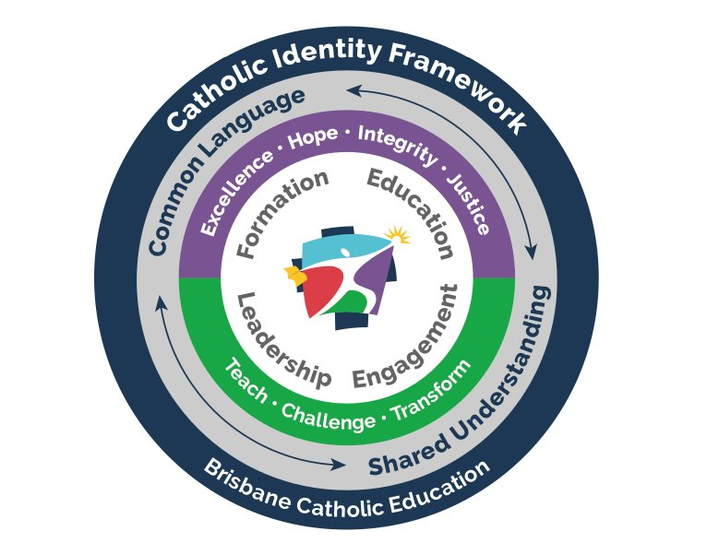
Catholic Identity Framework
© Brisbane Catholic Education (Formation and Engagement Services) 2024
Notes:
Strategic Directions: BCE Strategic Plan 2025 – 2027 Strategic Outcome “Deepen Understanding of the Catholic Christian Tradition for all”
Education Strategy: Connect with the Catholic Identity Framework to promote & strengthen the formation of staff

Slide 17
Executive Welcome

Slide 18
CORE: Curriculum Orientation Religious Education
Day 1 Session 1

Slide 19
Learning Outcomes
Sharing and developing ideas about the nature of being a teacher in a Catholic School
Understand my role as a teacher in a Catholic school
Understand changing approaches to Religious Education
Understand terms: recontextualisation & reconceptualisation

Slide 20
Today’s Topics
Changing approaches to religious education
Vision & Model for Religious Education
Parking lot:
Questions
Comments
Wonderings
Recontextualisation
Vs
Reconceptualisation
Three roles of the teacher
Navigating the RE Curriculum

Slide 21
Changing approaches to Religious Education
Study of Religion
Religion Curriculum
Christian Doctrine
Faith Formation
Catechesis
Education in Faith
religious instruction
faith sharing
Notes:
As you gain greater awareness of professional discussions about Religious Education you will hear many terms that will fit somewhere along a continuum between ‘Religious Instruction’ and ‘Faith Sharing’ .

Slide 22
Changing approaches to Religious Education
Catechism Approach
religious instruction
faith sharing
Notes:
Throughout the schools of the Archdiocese of Brisbane the following approaches have been evident: The Catechism Approach

Slide 23
Doctrine focused
Rote Learning
Notes:
In the centuries following the invention of the printing press, various councils of Bishops developed printed ‘Catechisms’ that became text books for use in Religious Education. Some very well known ones were a 1775 catechism by Archbishop Butler from Ireland and the Baltimore Catechism from the USA which was in use from 1885 – 1960s.
The pedagogy was the same as for all learning – Rote Learning and the use of memory.
(I have memories of my grandmother saying to us as children, “go and learn your Catechism”.)
In practice the classroom diet of catechism question and answer was often supplemented by stories, anecdotes and examples and by material drawn from the devotional life and religious practices of the Catholic tradition at the time. The study of scripture did not figure prominently in the catechism approach.

Slide 24
Changing approaches to Religious Education
Catechism Approach
Apologetics Approach
religious instruction
faith sharing
Notes:
Apologetics Approach

Slide 25
Apologetics
“Apologetics is the process of convincing ourselves and explaining to others that we are right.”
Notes:
Christian Apologetics is the field dedicated to explaining and defending the truths of the Christian faith, addressing both the reasons why believers hold their convictions and the questions or objections posed by skeptics. The term “apologetics” comes from the Greek word apologia, meaning a “defense” or “answer.” The ultimate aim is to remove intellectual stumbling blocks and invite people into deeper understanding, rather than to “win arguments” merely for the sake of victory. Apologetics focuses on providing the Catholic believer with the knowledge and skill to argue in favour of Catholic beliefs and practices and defend them from sceptics hostile to the Catholic faith. The apologetics approach assumed a Catholic tradition based upon faith and reason and able to be defended using reasoned argument.

Slide 26
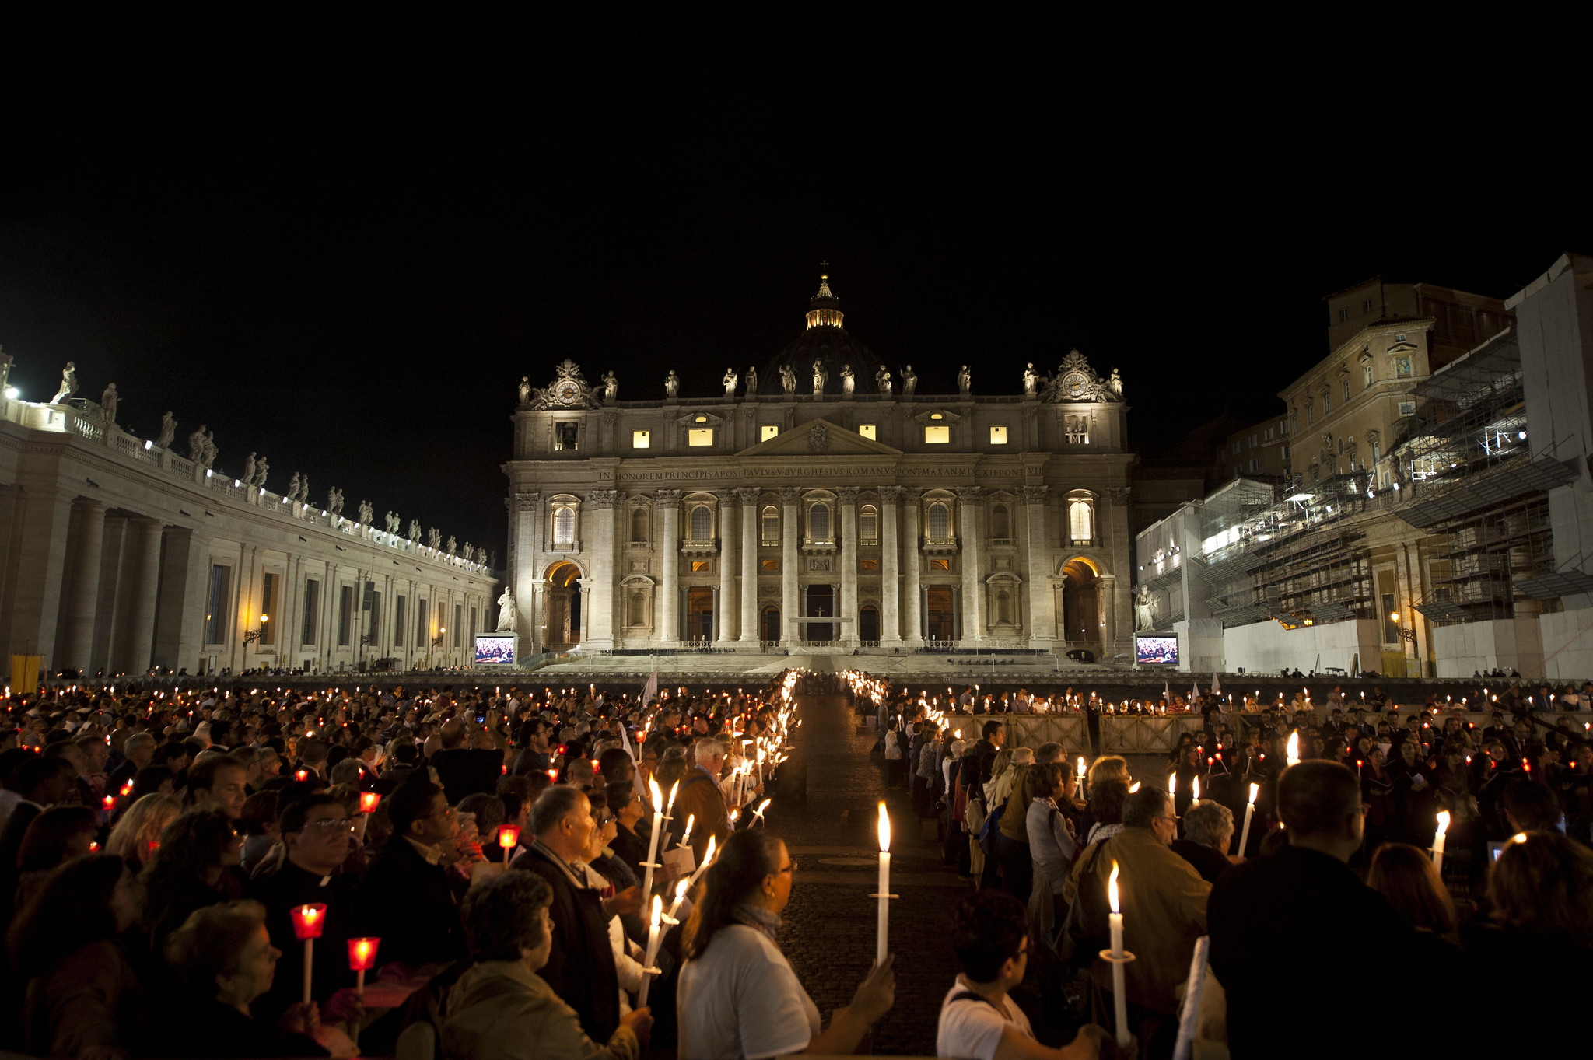
Changing Approaches to Religious Education: A Context
Vatican II 1962-1965
Called by Pope John XXIII and concluded by Pope Paul VI
Meeting of 2,500 bishops and leaders of men’s religious orders
Four sessions, October-December 1962-1965
Included observers from other religious communities, theological advisers, media, translators
Published 16 documents on Church issues and relations with the world
Many embraced changes; others resisted changes in Catholic culture
Implications for Religious Education
With Vatican II, there was a movement away from a Doctrinal or Catechetical Approach, which had been predominant from Post-Reformation to Vatican II
Also, around this time, the Kerygmatic Approach came into vogue (late 1950s early 60s). It overlaps somewhat with the doctrinal approach and emphasised scripture and personal relationship with Jesus.
Following Vatican II, there was movement away from these two approaches to various educational approaches.
WE WILL NOW EXAMINE THIS PERIOD OF TRANSITION IN MORE DETAIL
"Torchlit procession to mark the 50th anniversary of the Second Vatican Council at the Vatican" by Catholic Church (England and Wales) is licensed under CC BY-NC-SA 2.0.

Slide 27
Changing approaches to Religious Education
Catechism Approach
Apologetics Approach
Kerygmatic Approach
religious instruction
faith sharing

Slide 28
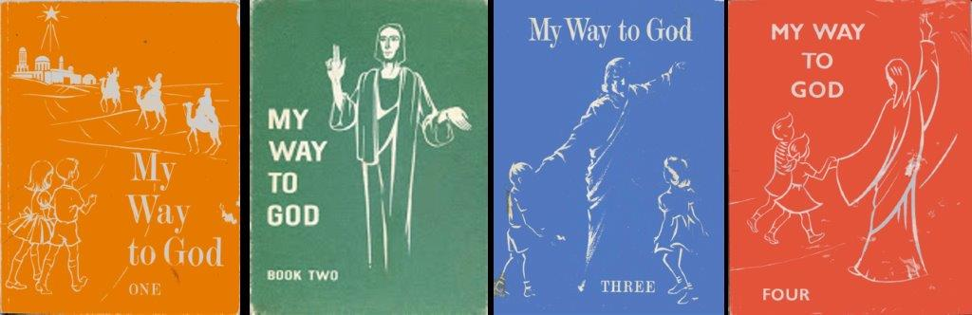
Kerygmatic approach
Scripture focused
Notes:
These were text books in Brisbane primary schools in the 1960s. The word kerygma is related to Greek words in the New Testament that mean to cry or proclaim as a herald. Kerygma is about the proclamation or announcement of the Good News of Jesus Christ. The kerygmatic approach was given impetus by advances in biblical scholarship in the twentieth century. Vatican II emphasised the importance of the Bible as the Word of God. The kerygmatic approach is oriented to the study of material from the Bible. The focus of the approach is on salvation history which reaches its fulfilment in the life, death and resurrection of Jesus Christ. Those who taught the kerygmatic approach typically linked their lesson with the Word of God proclaimed at each Sunday liturgy throughout the cycle of seasons of the liturgical year. Often one or more lessons during the week focused on the Gospel for the Mass of the coming Sunday

Slide 29
Changing approaches to Religious Education
Catechism Approach
Apologetics Approach
Kerygmatic Approach
Experiential Approach
religious instruction
faith sharing
Notes:
Throughout the schools of the Archdiocese of Brisbane the following approaches have been evident

Slide 30
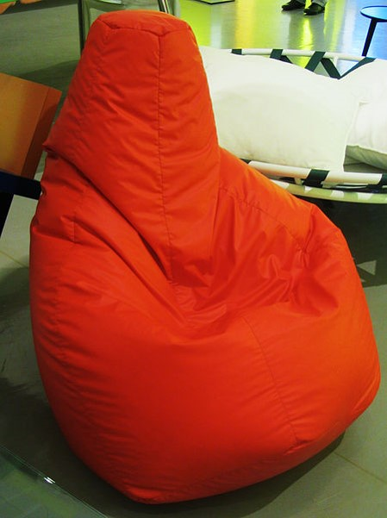
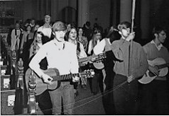
By Andrea Pavanello, Milano (Own work) [CC BY-SA 3.0 it (http://creativecommons.org/licenses/by-sa/3.0/it/deed.en)], via Wikimedia Commons
flickr photo by St. Mary's Episcopal Cathedral - Memphis https://flickr.com/photos/stmarysmemphis/3154395352 shared under a Creative Commons (BY-NC-ND) license
Life-Centred, Experiential Approach
Notes:
The life-centred experiential approach was about making religion relevant to the lives of young people. This was really big in the 1970s and is characterised by bean bags and folk masses.
This was a catechetical approach that began with the life experience of the young people… This was a direct outcome of Vatican II - experiential approach was about recognising that the Church continues to be a witness to revelation mediated through human experience.
This approach often lacked academic rigor -

Slide 31
Changing approaches to Religious Education
Catechism Approach
Apologetics Approach
Phenomenological Approach
Kerygmatic Approach
Experiential Approach
religious instruction
faith sharing
Notes:
Throughout the schools of the Archdiocese of Brisbane the following approaches have been evident

Slide 32
Phenomenology
Notes:
Phenomenology gave the Study of Religion some academic Rigor. It was based on the work of Ninian Smart who was a pioneer of secular religious studies at universities.
Ninian Smart identified seven dimensions of Religions and used this framework to study world religions.
Sometimes this study of religions from the ‘outside’ gives an inaccurate portrayal – each religion contains a very large variety of opinions and beliefs.

Slide 33
Changing approaches to Religious Education
Catechism Approach
Apologetics Approach
Phenomenological Approach
Kerygmatic Approach
Experiential Approach
religious instruction
faith sharing

Slide 34

Break
5-10mins

Slide 35
A reconceptualist approach to
Religious Education
Religious educators reconceive – or rethink ways in which classroom religion is most effectively understood in contemporary contexts:
Pluralist
Secular
Changing
Notes:
The reconceptualist approach came about as a result of the efforts by religious educators to reconceive or rethink ways in which classroom religion in schools is most effectively understood and implemented in a contemporary multicultural and multi-faith world.

Slide 36
Crawford and Rossiter
Gabriel Moran
Yoram Harpaz
the tragedy would be that that academic inquiry is not challenging enough, and formation is not particular enough
A powerful questioning pedagogy, within the context of a community of thinking, stimulates and supports genuine, active and authentic student engagement
Importance of creating ‘zones of freedom’ in the religion classroom for an authentic educational process and genuine student engagement
A Reconceptualist Approach
Notes:
A Reconceptualist Approach to RE in schools is elaborated and nuanced in a variety of ways in the work of a number of scholars. Key insights include:
Marisa Crawford and Graham Rossiter :
approaches to Religious Education that align with approaches in related curriculum areas are likely to be more educationally effective in a school context.
Religious education needs to be academically challenging from Year 1 to year 12; RE in primary school needs to keep pace with the level of critical pedagogy and critical content that pupils normally experience in other learning areas
The approach to studying the religious tradition needs more problem-posing content and a critical, student centred, research-oriented pedagogy
Gabriel Moran:
“Endless talk about Christianity is not religious education. What deserves that title is teaching people religion with all the breadth and depth of intellectual excitement one is capable of – and teaching people to be religious with all the particularity of the verbal and non-verbal symbols that place us on the way.”
Yoran Harpaz: Teaching and Learning in a Community of Thinking 2005
(Director, Mandel School of Educational Leadership, Jerusalem)
the ability to pose questions to understand ourselves and our world lies at the heart of what it means to be authentically human.
sees in many schools what he calls an ‘answering pedagogy’ where the underlying assumption is that knowledgeable teachers are asking ignorant students questions that are largely examining student recall rather than stimulating the genuine exploration of problems and issues

Slide 37
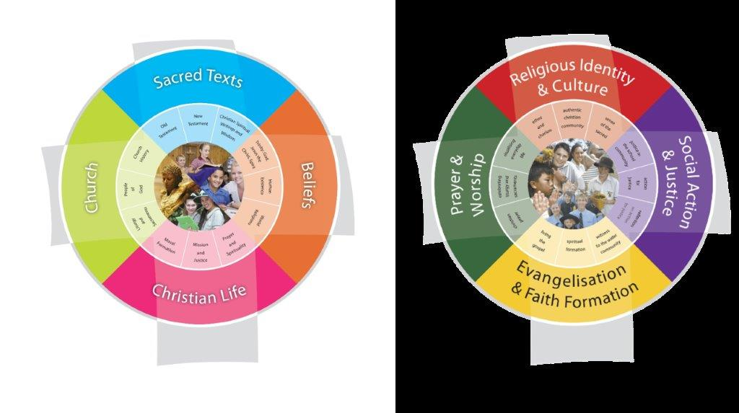
Model for Religious Education
Vision for
Religious Education
© Brisbane Catholic Education, Religious Education Curriculum P-12 Archdiocese of Brisbane (2013;2020 revised edition)
Notes:
Classroom teaching of religion and the religious life of the school.
Classroom – teaching about religion
Also inviting our students to experience how to be religious in a Catholic way – teaching them how to pray, how to participate respectfully in the liturgy of the Catholic Church, how to participate meaningfully in social action and justice activities.
Important to know what you are doing when you are doing it.

Slide 38
BCE Identifies ongoing patterns and discerns key areas to target strategically and resource
THEOLOGY AND METHODOLOGY KU LEUVEN / CECV RESEARCH
SCHOOLS continue to be invited to engage directly in the school based, Enhancing Catholic Schools Identity surveys.
Catholic Identity and Formation
Forming our staff!
Catholic Identity and Engagement
Growing our Communities!
Catholic Identity and Leadership
Enriching our Witness!
Catholic Identity, Education
Shaping our Curriculum!
Deepening Catholic Identity within and beyond our communities
e.g.
School Boards
Parent groups
Outreach agencies
Ecumenical & interfaith connections
Embedding a ‘head, heart and hands’ Catholic identity in all formation from induction to Leadership
Catholic Identity embedded within Education Strategy
Teaching for Learning: The Model of Pedagogy within RE
Targeted initiatives to strengthen our collective witness
Quality tools and resourcing to support our Mission
Notes:
Catholic Education Commission of Victoria (CECV) and the Faculty of Theology and Religious Studies at the
Catholic University of Leuven, Belgium – Enhancing Catholic Schools Identity Project
The surveys provide data for both schools and system as well as recommendations for school communities

Slide 39
Clarifying Terms
Reconceptualist
Recontextualist
Context
  Catholic School Identity
  Bringing the Catholic School culture into our current context.
Concept (re-thinking)
  Religious Education
  Forming new ideas
  Learning about Religion
  Learning from Religion
  Learning through Religion.
Notes:
At this point we will clarify some terms that we will be using today.

Slide 40
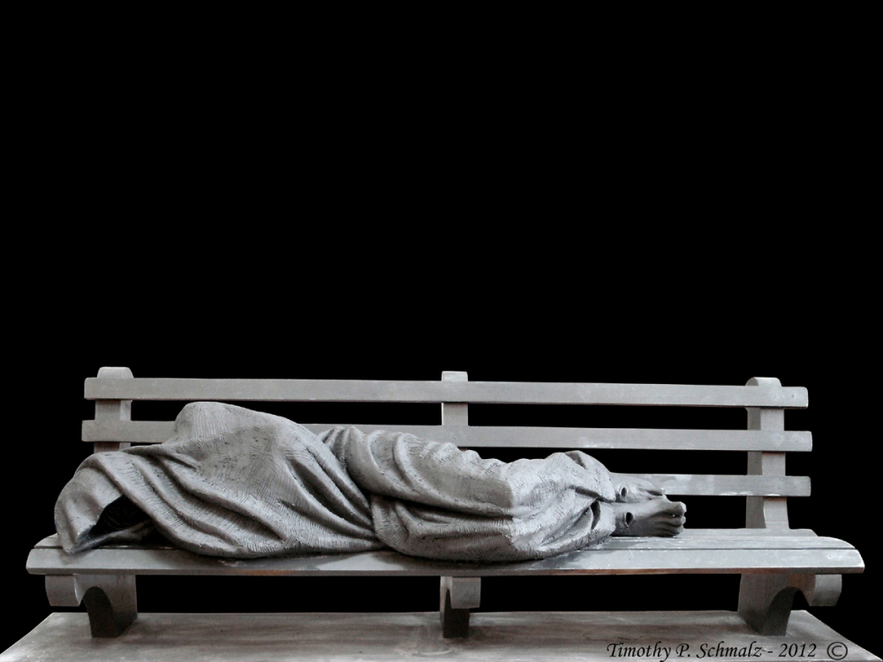
Recontextualised
I was hungry and you gave me food, I was thirsty and you gave me something to drink, I was a stranger and you welcomed me, I was naked and you gave me clothing, I was sick and you took care of me, I was in prison and you visited me… just as you did it to one of the least of these who are members of my family, you did it to me. (Matthew 25)
Notes:
This statue of Jesus by Timothy Schmalz portrays Jesus in our current context as shamefully homeless …

Slide 41
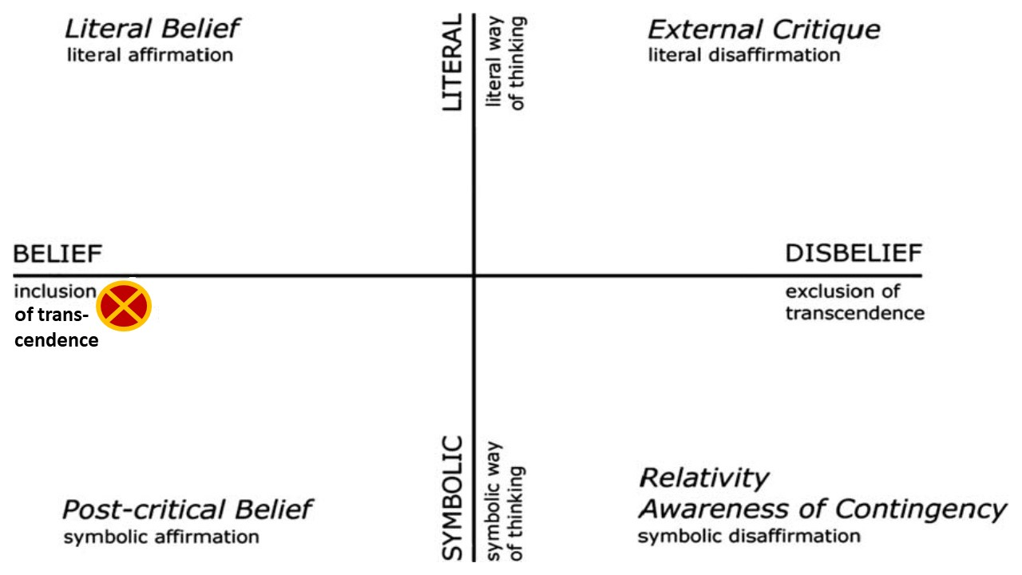
Post-Critical Belief
Pollefeyt, D. & Bouwens, J. (2010). Framing the identity of Catholic schools: empirical methodology for quantitative research on the Catholic identity of an education institute. International Studies in Catholic Education, 2(2), 193-211. doi:10.1080/19422539.2010.504034
Notes:
Post Critical Belief is a term comes from the work of a psychologist from the Catholic University of Leuven – it was developed in the 1990s
developed in the 1990s by a Leuven psychologist of religion.
Post-critical belief is one of four cognitive belief styles or religious attitudes that result from the combination of two dimensions. Belief (in transcendence) vs disbelief (exclusion of transcendence) and Symbolic vs Literal ways of thinking.

Slide 42
Post-critical belief
… challenged to live the gospel of Jesus Christ and who are literate in the Catholic and broader Christian tradition so that they might participate critically and authentically in faith contexts and wider society.
Notes:
Post-critical belief is a hope for our students as it is in alignment with our vision for Religious Education.

Slide 43
Elaborating on Post-critical belief
Post-Critical Belief denotes an affirmation of faith propositions as symbolic. It is characterised by belief in a God who is transcendent, deferring to a religious interpretation of reality wherein the transcendent is represented symbolically. God is the radical "other" to whom we relate through a symbolical representation, through the interpretation of a sign that refers to the transcendent rather than to a literal and immediate presence. People relate to the transcendent reality through the mediums of ritual and story, tradition and organisational structures. These render the transcendent reality present indirectly to the faith community (Pollefeyt and Bouwens, 2010, 197). For example, the Eucharist is a non-local (indirect) presence of Christ and not a local (direct) presence (Thomas Aquinas, Summa Theologica).
Didier Pollefeyt and Jan Bouwens. “Framing the identity of Catholic schools: empirical methodology for quantitative research on the Catholic identity of an education institute.” International Studies in Catholic Education 2 (2010): 193-211

Slide 44
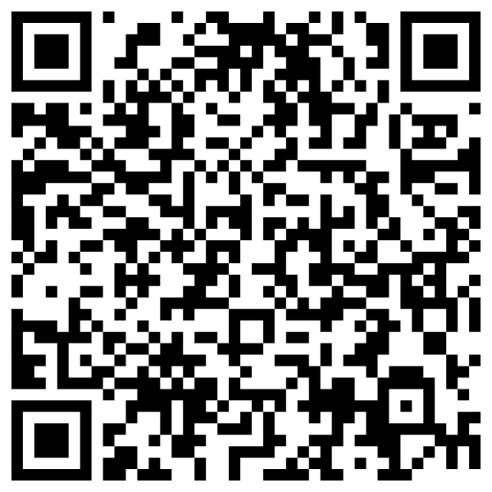
Vision for Religious Education
The Vision for Religious Education emphasises the complementarity of the two dimensions of Religious Education and articulates a school’s aspirations for students in terms of their religious literacy and faith formation. In that sense the Vision begins with “the end in mind”.

Slide 45
Develop your culture with wisdom. Ask culture what values it promotes, what destiny it offers, what place it makes for the poor and the disinherited, how it conceives of sharing, forgiveness, love.
Pope John Paul II (1984)

Slide 46
Learning Outcomes
Sharing and developing ideas about the nature of being a teacher in a Catholic School
Understand my role as a teacher in a Catholic school
Understand changing approaches to Religious Education
Understand terms: recontextualisation & reconceptualisation

Slide 47

Lunch
11:00am – 11:30am

Slide 48
For more information
Formation and Engagement Services
FES@bne.catholic.edu.au

