Slide 1

Copyright © 2026 Brisbane Catholic Education
This material has been copied and communicated to you in accordance with the statutory licence in section 113P of the Copyright Act 1968. Any further reproduction or communication of this material by you may be the subject of copyright protection under the Act.
Do not remove this notice.
This PowerPoint has been prepared by the Formation and Engagement Services, Brisbane Catholic Education.

Slide 2

Welcome

Slide 3
CORE Day 1
Middle Session

Slide 4
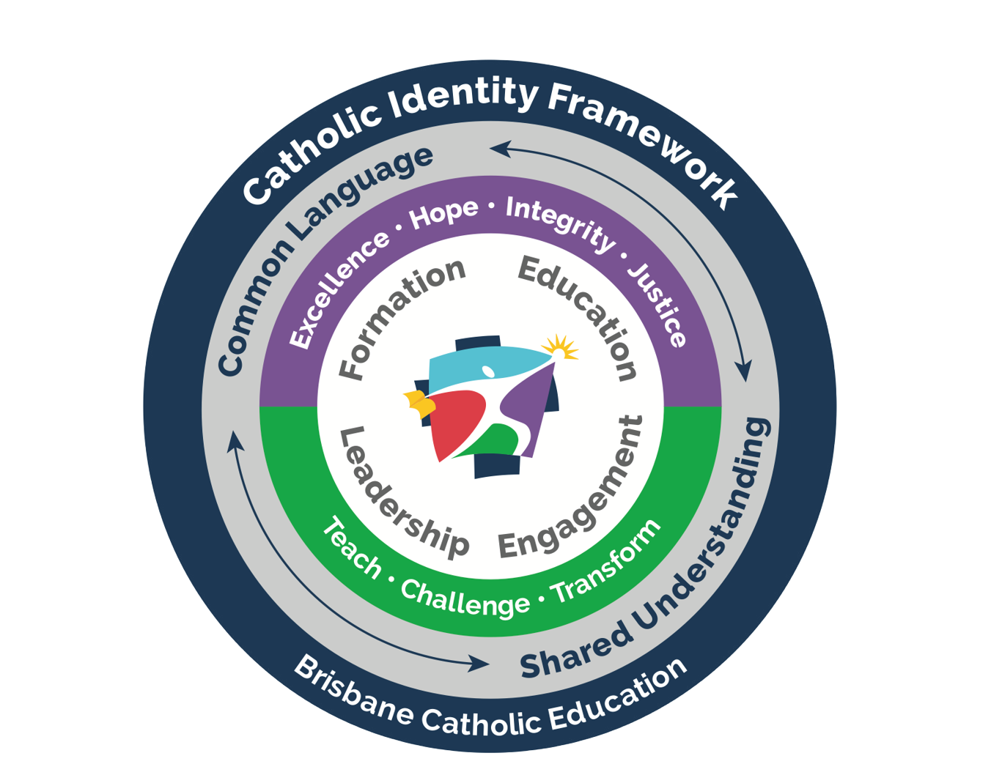
Catholic Identity Framework
Leadership
...Leadership of Catholic education is strengthened when stakeholders continue to develop in themselves and others religious literacy. Through the attainment of qualifications and accreditation, Catholic education fosters leaders who are authentic witnesses of the Catholic Tradition.
Education
Underpinning Education within the Catholic Identity Framework and with links to the Education Strategy, is the Religious Education Curriculum.
The P-12 Religion curriculum document, ‘Religious Education Curriculum P-12 Archdiocese of Brisbane (2013;2020 revised edition)’ is the authoritative source document for Religious Education in all Catholic and Ecumenical schools and colleges. It carries the imprimatur of the Archbishop of Brisbane, placing emphasis for religious education on the two complementary dimensions: Religion Curriculum P-12 and the Religious Life of the School.
Catholic social teachings across the curriculum, iconography and the inclusion of faith and culture further contributes to the educational element of the Catholic Identity Framework.
© Brisbane Catholic Education (Formation and Engagement Services) 2024

Slide 5
Learning Outcomes
Understanding the shape of Religious Education including the
Model for Religious Education
Reconceptualist Approach to teaching Religion
Roles of the Teacher

Slide 6
Model for Religious Education
© Brisbane Catholic Education, Religious Education Curriculum P-12 Archdiocese of Brisbane (2013;2020 revised edition)

Slide 7
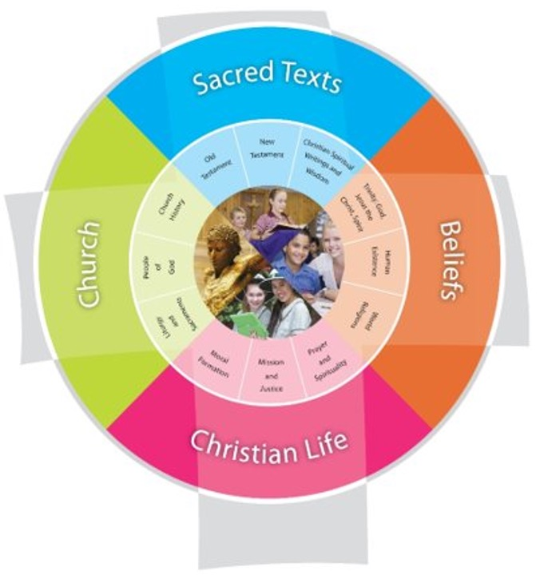
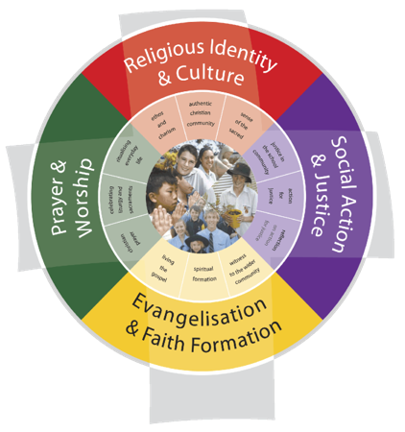
© Brisbane Catholic Education, Religious Education Curriculum P-12 Archdiocese of Brisbane (2013;2020 revised edition)

Slide 8
Teaching people Religion
© Brisbane Catholic Education, Religious Education Curriculum P-12 Archdiocese of Brisbane (2013;2020 revised edition)

Slide 9
Teaching people to be religious
in a particular way
© Brisbane Catholic Education, Religious Education Curriculum P-12 Archdiocese of Brisbane (2013;2020 revised edition)

Slide 10
Activity

Slide 11

Discussion
© Microsoft 365 content library, 2025​

Slide 12
Reconceptualist Approach
Avoidance of Presumptive Language
Teaching ‘about’ the Tradition
Powerful Pedagogies

Slide 13
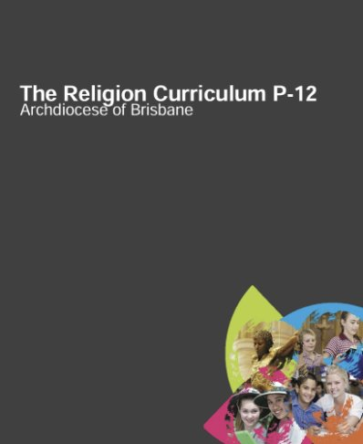
Activity
In pairs individually read:
Avoidance of Presumptive Language & Teaching about the Tradition (pg. 24-25)
Powerful Pedagogies (pg. 26-28)
Silently reflect using the round table discussion template (think, feel, wonder, do).
Jigsaw strategy: gain a deeper understanding of reconceptualist approach from your partner
Co-construct a definition for the Reconceptualist Approach & write this into the “Synthesis” section
Reconceptualist Approach to the Religion Curriculum P-12
© Brisbane Catholic Education, Religious Education Curriculum P-12 Archdiocese of Brisbane (2013;2020 revised edition)

Slide 14
The three roles of the teacher in Religious Education
Specialist
Moderator
Witness
Witness
Specialist
Moderator
“Difference Matters” by Didier Pollefeyt
Notes:
The most recent educational approach to rise to prominence in Australia is the hermeneutical-communitive approach. This approach has been developed as a result of the collaboration that has occurred between a number of Australian dioceses (notably the Archdiocese of Melbourne) and the Faculty of Theology at the Catholic University of Leuven in Belguim. This approach to teaching religion in the classroom links to broader initiatives to develop Catholic identity within schools. It also seeks to respond to some of the survey findings in various dioceses that have highlighted the challenges posed by secularism and the consequent need to develop a post-critical belief system that moves beyond "relativism and literalism to embrace symbolic religious imagination and critical thinking in a continuous re-interpretation of faith" (Catholic Education, Archdiocese of Brisbane, 2016).

Slide 15
Specialist
Deep knowledge of matters concerning Christianity, Catholicism, and other religions and philosophical traditions is offered.
Witness
Faith is presented as a living faith and an attractive option with a humble and supportive attitude.
Moderator
Students’ issues, experiences, thinking and Catholic traditions are brought into dialogue.
(Pollefeyt, Difference Matters, 2008)
Notes:
The Hermeneutical-Communicative approach highlights the need for the religion teacher to understand how students engage in meaning making. From this perspective, dialogue between one's own beliefs and those of others is crucial in the religion classroom. In the context of the religion classroom, the individual student encounters material drawn from the Catholic tradition and is meant to critically assimilate those beliefs and teachings with previously held understandings in order to develop new ways of seeing the world. This occurs through an active process of dialogue. The following diagram (Archdiocese of Melbourne, 2018, p. 10) demonstrates how the approach is meant to be enacted in the religion classroom:
You have to Witness the faith that you are presenting. You may not in fully align with all teaching of The Church but you have engaged and continue to engage and struggle with the faith and teachings.
As Specialist you are always improving your knowledge and understanding of The Church and other faith traditions so you are able to engage in dialogue with your students.

Slide 16
The three roles of the teacher
As Witness:
Teachers authentically, with enthusiasm and vulnerability, offer their constructed, particular and Christian synthesis of faith understood as a work-in-progress.
As Specialist:
Teachers draw artfully upon their good levels of knowledge and theological expertise about Christianity, the Catholic faith and other life philosophies and religions.
(RE Curriculum P-12, p. 13)

Slide 17
The three roles of the teacher
As Moderator
The moderator creates opportunities for young people to voice their questions and in an environment in which they are able to grapple with their questions without feeling judged.
(RE Curriculum P-12, p. 13)
The “religious educator is someone who is at the same time rooted in his/her own Tradition yet open towards other religious or ideological traditions and young people’s search for their own identity (meaning).”
“S/he accepts and confirms that also other valuable representations exist of the human search for meaning in life.”
(“Difference Matters” by Didier Pollefeyt)

Slide 18

Activity
Reflect & Share
Who are my models?
How do/would I engage as witness, moderator, specialist?
Share with table group
© Microsoft 365 content library, 2025​

Slide 19

Thoughts or Questions
© Microsoft 365 content library, 2025​

Slide 20
Learning Outcomes
Understanding the shape of Religious Education including the
Model for Religious Education
Reconceptualist Approach to teaching Religion
Roles of the Teacher

Slide 21

Afternoon Tea
© Microsoft 365 content library, 2025​

Slide 22
For more information
Formation and Engagement Services
FES@bne.catholic.edu.au

