Slide 1

Copyright © 2026 Brisbane Catholic Education
This material has been copied and communicated to you in accordance with the statutory licence in section 113P of the Copyright Act 1968. Any further reproduction or communication of this material by you may be the subject of copyright protection under the Act.
Do not remove this notice.
This PowerPoint has been prepared by the Formation and Engagement Services, Brisbane Catholic Education.

Slide 2
Day 1 – Afternoon Session

Slide 3
Learning Outcomes
Participants are deepening their understanding of the shape of Religious Education in the Archdiocese of Brisbane.

Slide 4
Curriculum Discovery: Year Level
Focus on learners and their learning …

Slide 5
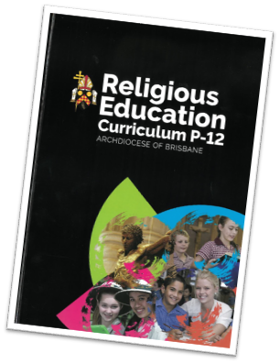
ACTIVITY: Learning Entitlement​
Find out more about the ‘learning entitlement’ for your students. Refer to the relevant pages from the following section of your Religious Education book:​
​Learners and Learning in the Religion Classroom ​
(pp. 31-34)​
Save the last word …
© Brisbane Catholic Education, Religious Education Curriculum P-12 Archdiocese of Brisbane (2013;2020 revised edition)

Slide 6
Save the last word…
Read and highlight three things that stood out for you in the text, that speaks to your experience or that you found interesting or challenging.
Write a few sentences explaining why you chose each quote or highlighted section.
In groups one person (A) shares their quote, the other people (B, C) discuss reason why they think (A) chose the quote. A then reads their notes as to why.
The same process happens for person B and C.

Slide 7
Navigating the Religion Curriculum P-12
Key considerations for planning

Slide 8

Revised edition 2020
© Brisbane Catholic Education, Religious Education Curriculum P-12 Archdiocese of Brisbane (2013;2020 revised edition)

Slide 9

Religious Education Curriculum P-12
A Catholic view about learning and teaching
A reconceptualist approach
Teaching scripture in the classroom
Learners and learning in the religion classroom
Design principles for the religious curriculum P-12
Structure of the religion curriculum P-12
Religious Education Curriculum-P12
© Brisbane Catholic Education, Religious Education Curriculum P-12 Archdiocese of Brisbane (2013;2020 revised edition)

Slide 10
RE curriculum
The structure and organisation of the Curriculum is built on the Australian Curriculum model – influenced by HASS/History and English pedagogy
What is common?
Achievement Standard
Content Descriptions
Cognitions
Skills
Elaborations
General Capabilities
Learning Intentions and Success Criteria
Questioning pedagogy and Inquiry Approach
Text and Context
Assessment addresses the Achievement Standard
© Brisbane Catholic Education, Religious Education Curriculum P-12 Archdiocese of Brisbane (2013;2020 revised edition)
Notes:
Discuss in groups first before showing

Slide 11
What is different?
Content
Skills and Knowledge not separated in the Achievement Standard
Prayer Participation
Prayer is in the Achievement Standard
Scripture as a text
Religious Life of the School
© Brisbane Catholic Education, Religious Education Curriculum P-12 Archdiocese of Brisbane (2013;2020 revised edition)

Slide 12

Teaching for Learning
Model of Pedagogy, Curriculum Compass © Brisbane Catholic Education (2025).

Slide 13
Teaching for Learning in Religion
Focus on the learner
Establish
Activate and Support
Evaluate and Respond
Identify the learning destination – Year Level Description / Achievement Standard / Content Descriptions
Carefully plan a route
Make regular checks on progress on the way – Feedback and Assessment
Feedback that moves learning forward
Establish where the students are in their learning
Teaching and Learning Sequence
Begin the learning journey

Slide 14
Planning in Religious Education using the Model of Pedagogy
Focus on the learner
Establish
Activate and Support
Evaluate and Respond
Begin with the curriculum (Year Level Overview / Curriculum and Assessment Plan)
Teaching and Learning Sequence
Evaluate the effect of teaching on student achievement and success
Plan with the End in Mind (Assessment Resources)
Feedback that moves learning forward
Who are my learners?

Slide 15
Focus
Developing shared clarity about learning
For each learning area, the approved curriculum emphasises the knowledge, understanding and skills that form the entitlement of a learning area.

Slide 16
Focus
Focus on learners and their learning
• Identify progress, prior achievement and development of learners and their learning
• Begin with the approved curriculum
• Identify learners’ levels of thinking
• Plan to accelerate the cognitive levels of all students
• Recognise the attributes students bring to the classroom
Model of Pedagogy, Curriculum Compass © Brisbane Catholic Education (2025).

Slide 17
Focus
Activity
Access a unit of work for your year level in Religious Education.
Find where you add detail about your learners and learning.

Slide 18
Planning in Religious Education using the Model of Pedagogy
Focus on the learner
Establish
Activate and Support
Evaluate and Respond
Begin with the curriculum (Year Level Overview / Curriculum and Assessment Plan)
Teaching and Learning Sequence
Evaluate the effect of teaching on student achievement and success
Plan with the End in Mind (Assessment Resources)
Feedback that moves learning forward
Who are my learners?

Slide 19
Establish
The better teachers know the curriculum, the better able they are to define exactly, for themselves and for their students, what it is students need to learn.

Slide 20
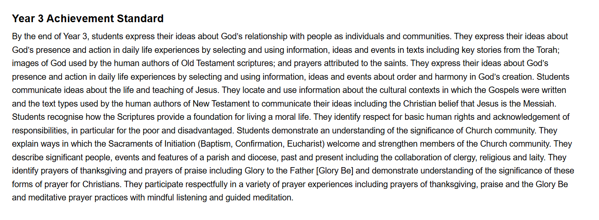
Establish
The achievement standard is the measure for each student’s learning progress and achievement.
Use the standard as the beginning point for speaking about student learning.
© Brisbane Catholic Education, Religious Education Curriculum P-12 Archdiocese of Brisbane (2013;2020 revised edition)

Slide 21
What type of standard is it?
The Achievement Standard describes and illustrates the level of learning that is needed to successfully continue to new learning in the sequence.
High expectations for students enable us to use this as a reference point for planning for students’ learning and how they will achieve beyond it.

Slide 22
Nature of the Achievement Standards
Framework of growth and development
- in each year level
- across P-10
- describes a broad sequence of learning
Prep
1
2
3
4
5
6
7
8
9
10
Year 9
1
PREP

Slide 23
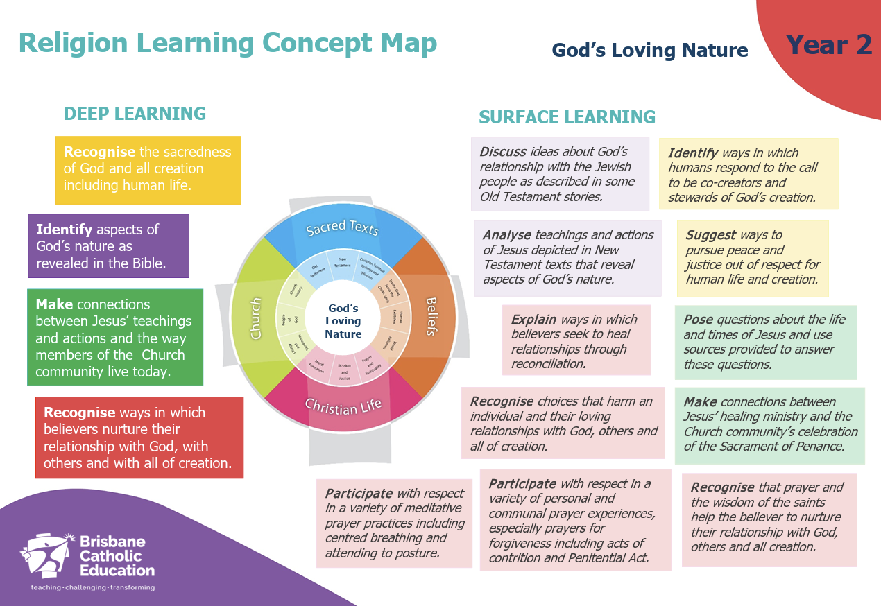
Establish - Big Ideas
Each Year Level has a ‘big idea’, for example Year 2 is God’s Loving Nature.
We can then dive deeper into Deep and Surface Learning.
© Brisbane Catholic Education, Religious Education Curriculum P-12 Archdiocese of Brisbane (2013;2020 revised edition)

Slide 24
Establish - The ‘Line of Sight’
Achievement Standards
Year Level Descriptions
Content Descriptions
  inter-related strands (Church, Sacred Texts, Beliefs, Christian Life)
  sub-strands
  skills – elaborations
Core Scripture
Explicit Prayer

Slide 25
Strands
Strands and Sub Strands
Sacred Texts (Old Testament, New Testament, Christian Spiritual Writings and Wisdom)
Beliefs (Trinity, Human Existence, World Religions)
Church (Liturgy and Sacraments, People of God, Church History)
Christian Life (Moral Formation, Mission and Justice, Prayer and Spirituality)

Slide 26
Content Descriptions – code
Eg BEHE2
Strand - BE – Beliefs
Substrand – Human Existence
Number - 2

Slide 27
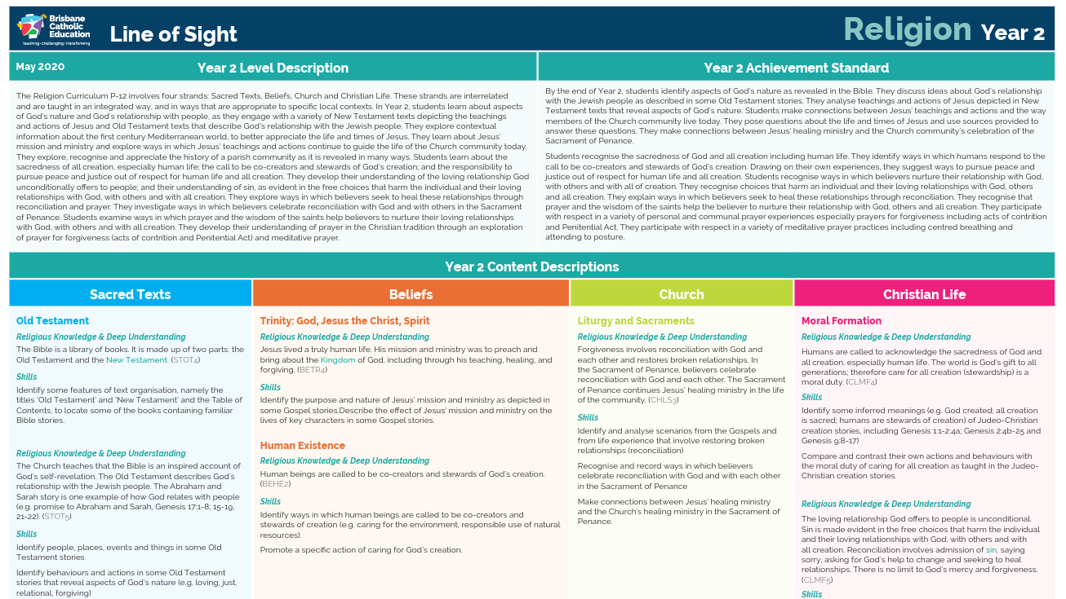
© Brisbane Catholic Education, Religious Education Curriculum P-12 Archdiocese of Brisbane (2013;2020 revised edition)

Slide 28
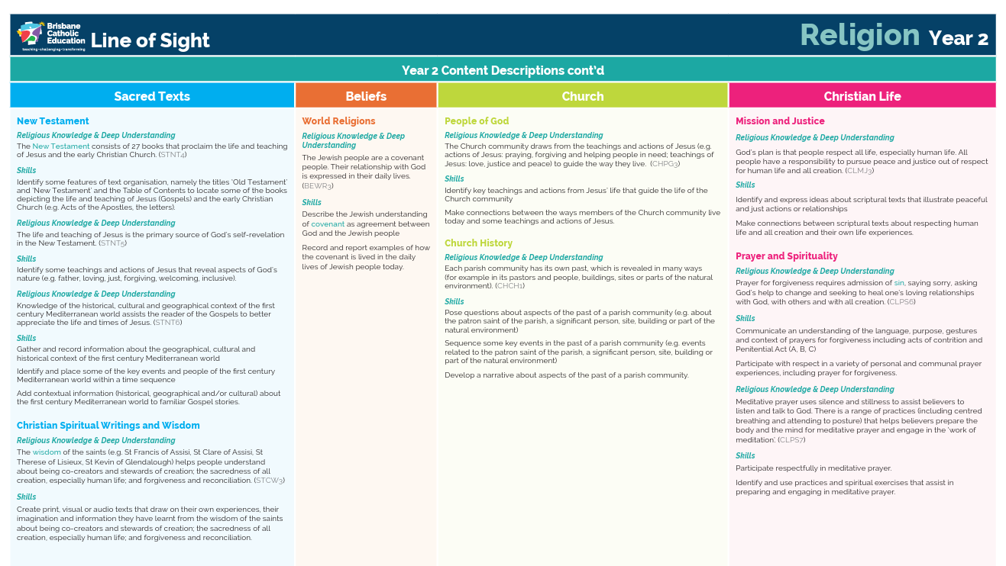
© Brisbane Catholic Education, Religious Education Curriculum P-12 Archdiocese of Brisbane (2013;2020 revised edition)

Slide 29
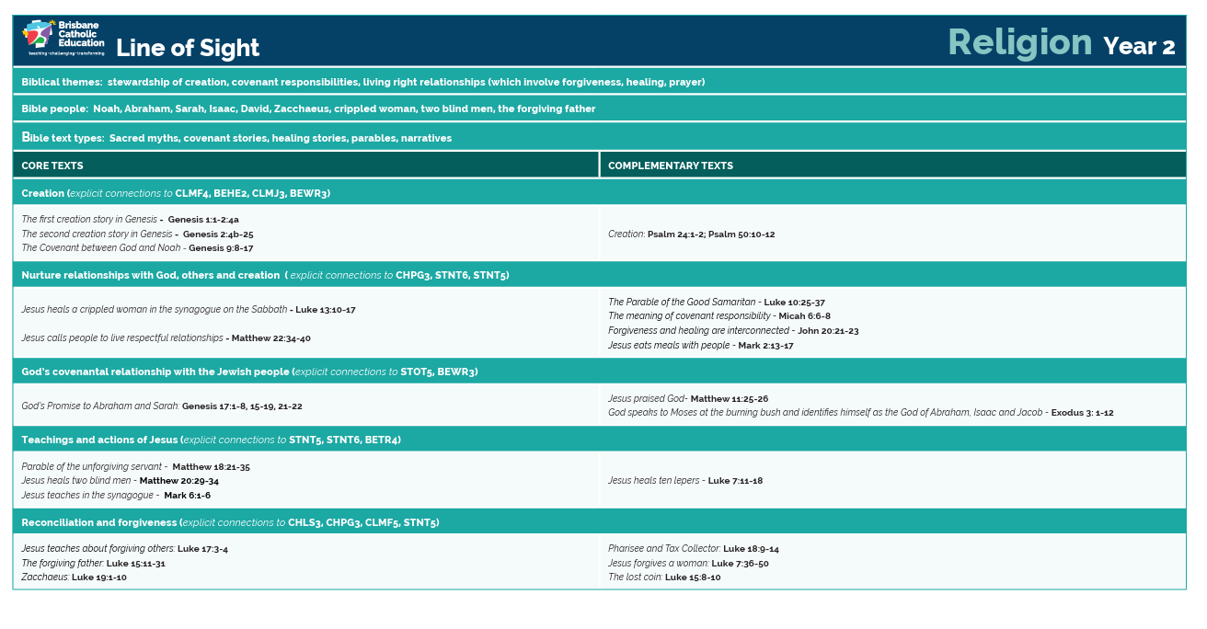
© Brisbane Catholic Education, Religious Education Curriculum P-12 Archdiocese of Brisbane (2013;2020 revised edition)

Slide 30
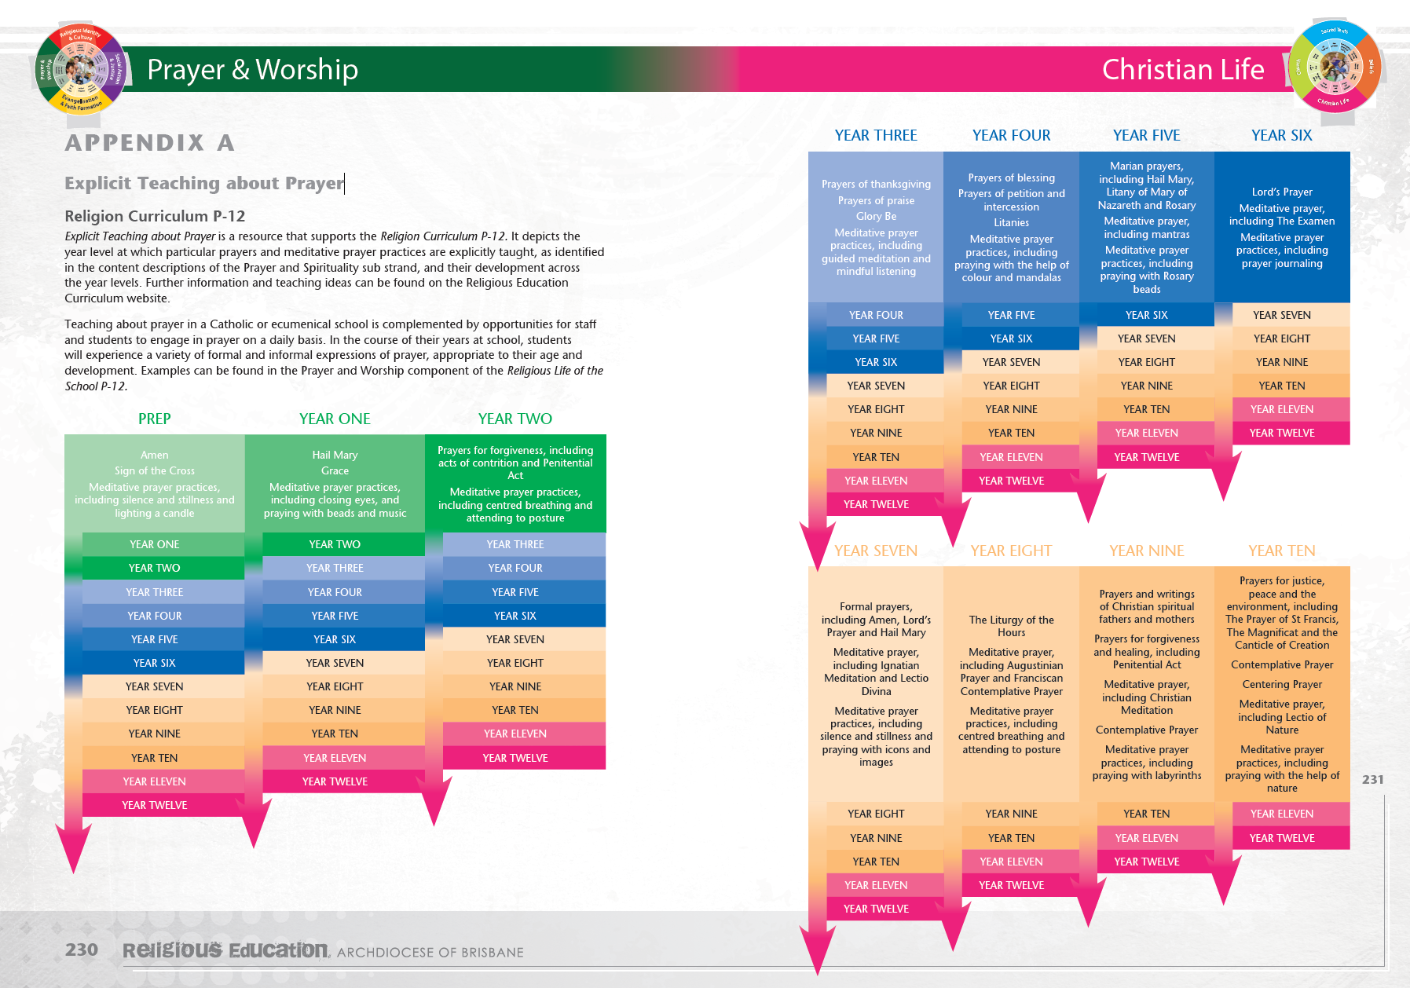
Explicit Prayer
© Brisbane Catholic Education, Religious Education Curriculum P-12 Archdiocese of Brisbane (2013;2020 revised edition)

Slide 31
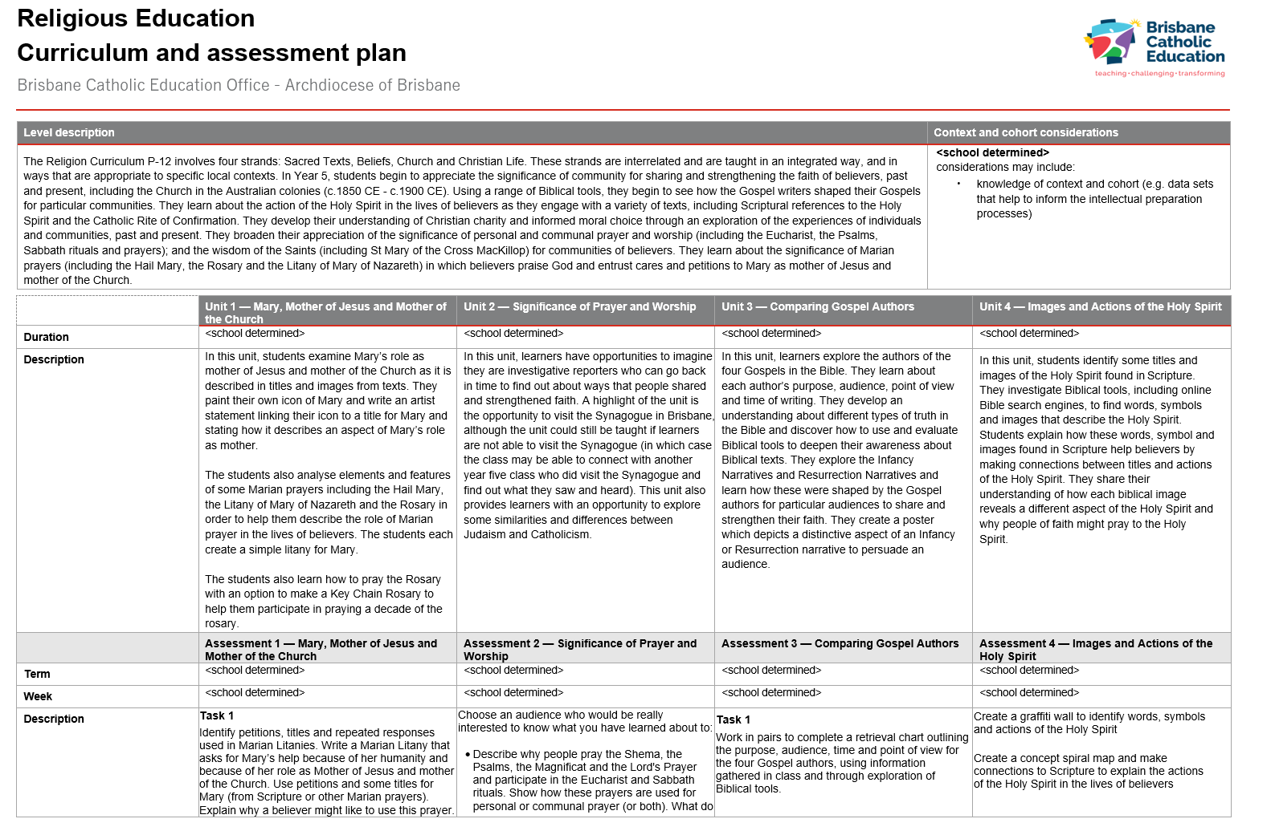
Establish
Begin with the approved curriculum- Year Level Overview or CAP
© Brisbane Catholic Education (Formation and Engagement Services) 2025

Slide 32
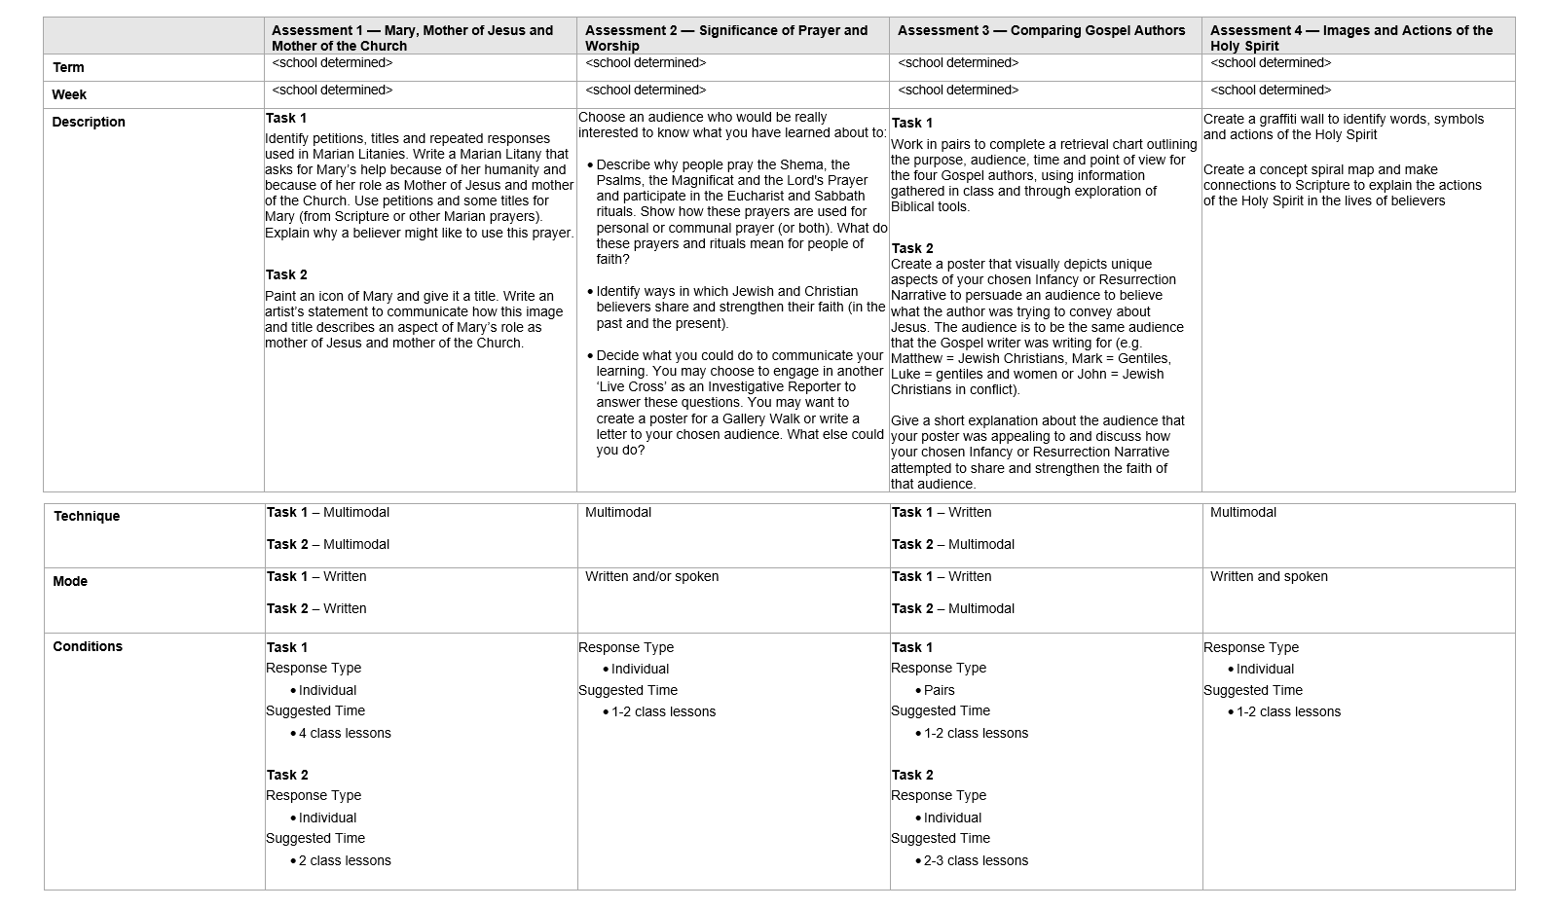
Establish
© Brisbane Catholic Education (Formation and Engagement Services) 2025

Slide 33
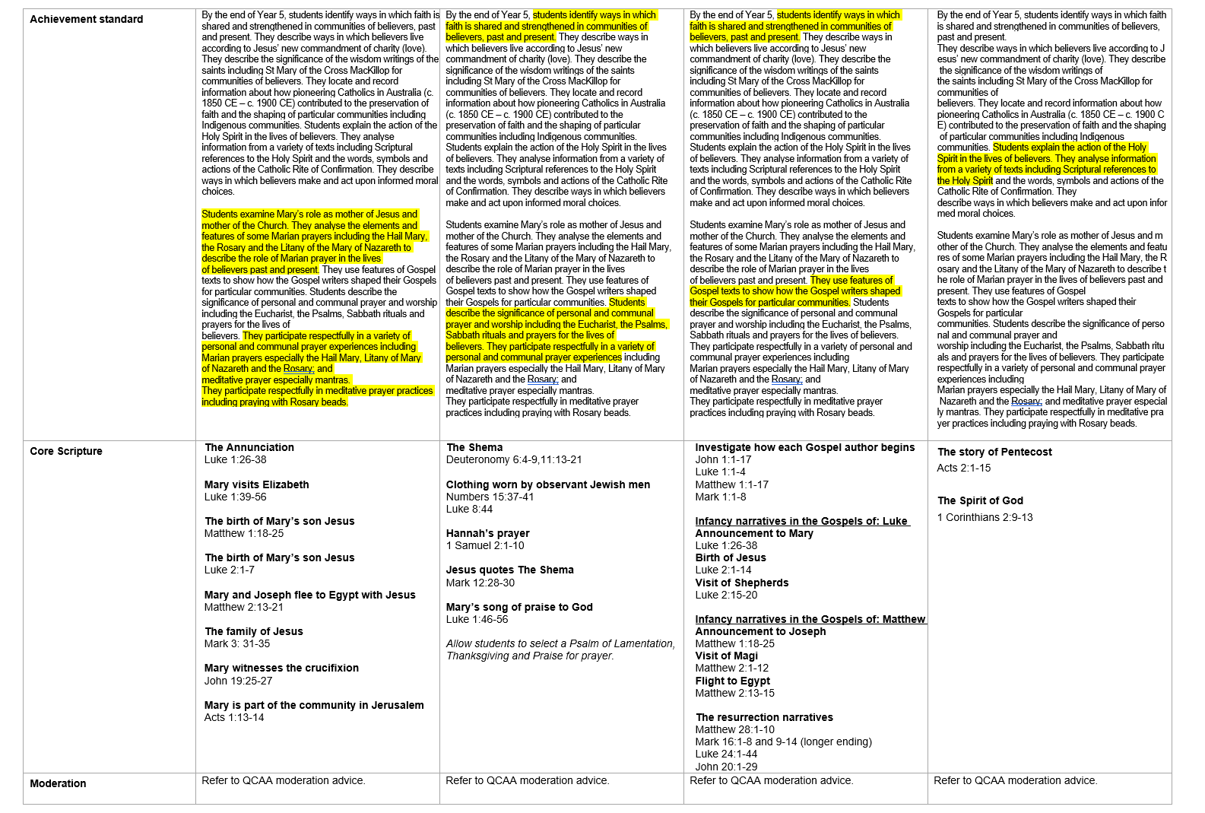
Establish
© Brisbane Catholic Education (Formation and Engagement Services) 2025

Slide 34
Establish
Begin with the approved curriculum
Activity
Find and highlight on the unit the approved curriculum:
Achievement standard – (deep / surface learning)
Content descriptions
Core Text
Explicit Prayer
General Capabilities / Cross Curricular Priorities
Is this reflected in the clear learning intentions & success criteria?

Slide 35
Planning in Religious Education using the Model of Pedagogy
Focus on the learner
Establish
Activate and Support
Evaluate and Respond
Begin with the curriculum (Year Level Overview / Curriculum and Assessment Plan)
Teaching and Learning Sequence
Evaluate the effect of teaching on student achievement and success
Plan with the End in Mind (Assessment Resources)
Feedback that moves learning forward
Who are my learners?

Slide 36
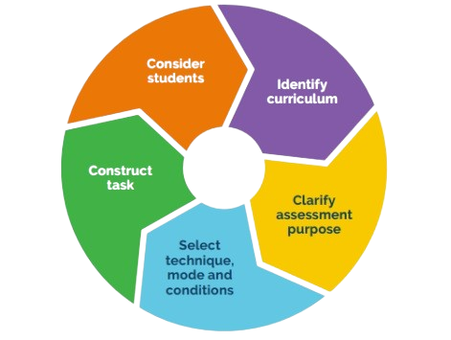
Establish
Plan with the End in Mind
Being an Assessment Literate Teacher
Assessment literate teachers gather evidence of student progress to inform teaching and to make judgments about achievement, this is achieved when teachers:
Plan with the end in mind
© Brisbane Catholic Education, Curriculum Compass Archdiocese of Brisbane (2024;2025 revised edition)

Slide 37
Establish
Activity
Find and highlight on the unit of work, examples of Formative and Summative Assessment.

Slide 38
Planning in Religious Education using the Model of Pedagogy
Focus on the learner
Establish
Activate and Support
Evaluate and Respond
Begin with the curriculum (Year Level Overview / Curriculum and Assessment Plan)
Teaching and Learning Sequence
Evaluate the effect of teaching on student achievement and success
Plan with the End in Mind (Assessment Resources)
Feedback that moves learning forward
Who are my learners?

Slide 39
Activate and Support
Activate multiple opportunities
Begin planning your learning experiences for your students
Consider how you will explicitly teach using the Gradual Release of Responsibility to scaffold and respond flexibly
Knowing your learners, what support might they need to progress?
Model of Pedagogy, Curriculum Compass © Brisbane Catholic Education (2025).

Slide 40
Activate
General Capabilities
Cross Curriculum Priorities
RLOS
Inquiry
Teaching and learning sequence

Slide 41
Activate and Support
Some pedagogical approaches used in Religious Education:
Inquiry learning
Explicit teaching
Questioning
These will be explored in more detail tomorrow.

Slide 42
Planning in Religious Education using the Model of Pedagogy
Focus on the learner
Establish
Activate and Support
Evaluate and Respond
Begin with the curriculum (Year Level Overview / Curriculum and Assessment Plan)
Teaching and Learning Sequence
Evaluate the effect of teaching on student achievement and success
Plan with the End in Mind (Assessment Resources)
Feedback that moves learning forward
Who are my learners?

Slide 43
Evaluate
Evaluate the effect of teaching on student achievement and success
What did I observe from my previous cycle? (This could be the previous year)
What did my assessment tell me?
What went well and what needs revisiting
    from a curriculum perspective
    engagement levels
    learner dispositions and ways of working
    from the perspective of my students
Model of Pedagogy, Curriculum Compass © Brisbane Catholic Education (2025).

Slide 44
Planning in Religious Education using the Model of Pedagogy
Focus on the learner
Establish
Activate and Support
Evaluate and Respond
Begin with the curriculum (Year Level Overview / Curriculum and Assessment Plan)
Teaching and Learning Sequence
Evaluate the effect of teaching on student achievement and success
Plan with the End in Mind (Assessment Resources)
Feedback that moves learning forward
Who are my learners?

Slide 45
Respond
Respond with feedback that moves learning forward
Students should be provided with opportunities to improve their knowledge, understanding and skills through effective feedback that:
  is timely, specific and related to the learning intentions and success criteria
  is constructive and provides meaningful information to students about how to improve
  informs future teaching and learning opportunities
Model of Pedagogy, Curriculum Compass © Brisbane Catholic Education (2025).

Slide 46
Shared clarity In the classroom
Both teacher and students are able to describe:
what is to be learnt – using learning intentions
how the learning intention relates to the “big ideas”
how the learning is relevant
how students will go about the learning
how students will know it has been learnt – using success criteria with reference to exemplars, examples, and modelling.

Slide 47

Questions

Slide 48
Learning Outcomes
Participants are deepening their understanding of the shape of Religious Education in the Archdiocese of Brisbane.

Slide 49
Assignment 1
Overview key components

Slide 50
Assignment 1
TASK
Evaluate (explain and justify) the significance of utilising the Reconceptualist Approach for teachers of Religious Education in a Catholic school in the Archdiocese of Brisbane, as they respond to the contemporary contexts of the learner.
Length: 2000 words

Slide 51
Assignment 1 - template
Introduction 150-200 words
State the intention of the task – outlining your hypothesis/position on the level of significance and provide reasons/signposts why you are taking this position

Slide 52
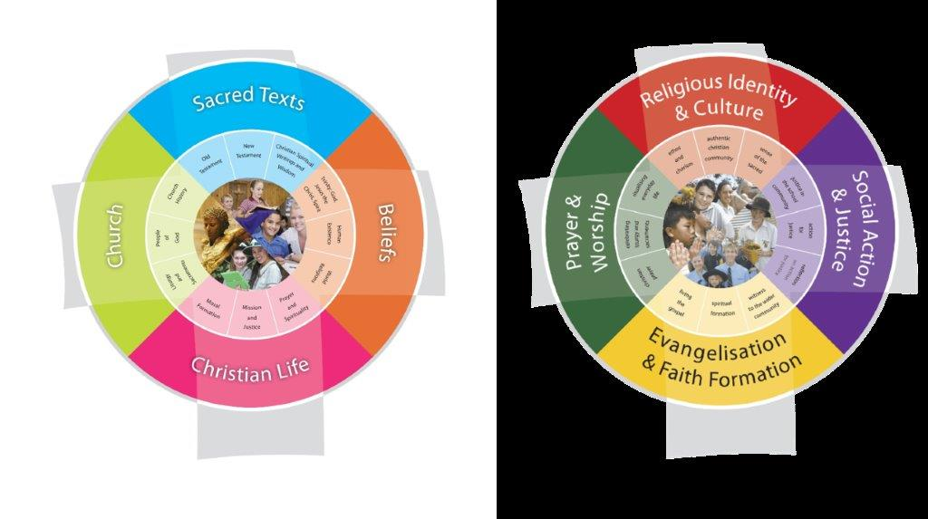
Background
Two dimensions of Religious Education:
The classroom teaching of Religion The Religious Life of the School
Vision for
Religious Education
© Brisbane Catholic Education, Religious Education Curriculum P-12 Archdiocese of Brisbane (2013;2020 revised edition)
Notes:
Essay Plan
Introduction:
Hypothesis and position
150-200 words
State the intention of the task – outlining your hypothesis/position on the level of significance and provide reasons/signposts why you are taking this position
Body
Demonstrate understanding, analysis, evaluation and references to support throughout.
Understanding of: The vision and purpose (why) of Religious Education in schools in the Archdiocese of Brisbane taking into account the contemporary contexts (recontextualised) of our learners. 200 words
To begin review the Two dimensions of Religious Education – page 21

Slide 53
Assignment 1 - Template
Body
Demonstrate understanding, analysis, evaluation and references to support throughout.
Understanding of: The vision and purpose (why) of Religious Education in schools in the Archdiocese of Brisbane taking into account the contemporary contexts (recontextualised) of our learners. 200 words

Slide 54
The Vision for Religious Education
1. The Vision for Religious Education emphasises the complementarity of the two dimensions of Religious Education and articulates a school’s aspirations for students in terms of their religious literacy and faith formation.
Notes:
Have you got the right definition of Vision – Moran = P.10
Body
Demonstrate understanding, analysis, evaluation and references to support throughout.
Understanding of: The vision and purpose (why) of Religious Education in schools in the Archdiocese of Brisbane taking into account the contemporary contexts (recontextualised) of our learners. 200 words
What is the vision – page 10/11

Slide 55
Contemporary Contexts
School Religious Education
Societal
Ecclesial
Educational
Digital
Notes:
Body
Understanding of: The vision and purpose (why) of Religious Education in schools in the Archdiocese of Brisbane taking into account the contemporary contexts (recontextualised) of our learners. 200 words
Why – Contemporary contexts – Page 14 - 17
Societal
Many students want to come to our school. Why? - many want a Catholic School education but they do not fully understand the foundational nature and central importance of religious and spiritual dimension of Catholic education.
Ecclesial
Roy Williams states in his book Post God Nation? says in the 1901 census, 96% of respondents identified as Christian and half the adults regularly attended church. A century on 61% of the population identify as nominally Christian and only 8% regularly attend services of worship. What happened?
The school is often the place where students and their families encounter the mission and outreach of the Church, especially through pastoral care and the experience of Catholic Christian community.
Educational
Catholic schools Integrate Faith, Life and Culture challenging negative societal influences that impact upon the spiritual wellbeing of students e.g. Support for the inner journey, developing peaceful hearts, listening to the voice of God and others, discernment, individualism, narcissism, moral relativism and consumerism.
Digital
RE seeks to engage students in the critical, creative and responsible use of digital tools - digital citizenship Opportunities to connect in global context

Slide 56
Assignment 1 - Template
Body
Demonstrate understanding, analysis, evaluation and references to support throughout.
Explain: The importance of engaging learners in the two distinct yet complementary dimensions of religious education (as conceptualised in the Model for Religious Education) in order to fulfill the Vision for Religious Education, citing examples from your professional experience. 300 words

Slide 57
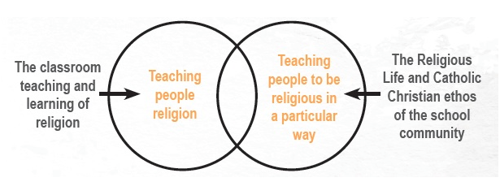
2. Model of Religious Education
© Brisbane Catholic Education, Religious Education Curriculum P-12 Archdiocese of Brisbane (2013;2020 revised edition)
Notes:
2. Explain: The importance of engaging learners in the two distinct yet complementary dimensions of religious education (as conceptualised in the Model for Religious Education) in order to fulfill the Vision for Religious Education, citing examples from your professional experience.
300 words
Model of religious Education – explain slide
Each is distinct yet they are complimentary – link with professional experience examples – how does the teaching in the classroom link to the religious life of the school ie -

Slide 58
Assignment 1 - Template
Body
Demonstrate understanding, analysis, evaluation and references to support throughout.
Explain how: – The Reconceptualist Approach to the teaching of Religion (the three key considerations) engages the plurality of voices to enable learner dialogue for the development of post-critical belief. (Justify the importance of such dialogue – providing reasons) 300 words

Slide 59
The Reconceptualist Appoach
Three considerations (pp 24 – 27):
  Avoidance of presumptive language
  Teaching ‘about’ the tradition
  Powerful pedagogies
Dialogue
Post-critical belief
  (participate critically and authentically in faith contexts)
Notes:
This is the point to the assignment – why are these things critical as an approach
Other dioceses might have a different approach – does it work
Why is this the approach needed for the current context of our schools
3. Explain how: – The Reconceptualist Approach to the teaching of Religion (the three key considerations) engages the plurality of voices to enable learner dialogue for the development of post-critical belief. (Justify the importance of such dialogue – providing reasons)
300 words
Reconceptualist approach read slide
Ensure to include the connection of the considerations to the plurality of voices / to enable leaner dialogue / for the development of the post critical belief

Slide 60
Assignment 1 - Template
Body
Demonstrate understanding, analysis, evaluation and references to support throughout.
Explain why: The pivotal importance of the roles of the teacher (all three) for effective Religious Education of all learners in contemporary Catholic schools (the learners will be more than consumers of the tradition) Evaluate the why here - the pivotal importance. 400 words

Slide 61
Three roles of the teacher
Witness
Specialist,
Moderator
Notes:
The importance of dialogue and leading this in the classroom teaching religion – be open to the queries
Unpack these – you heard about these in the first session today
Explain why: The pivotal importance of the roles of the teacher (all three) for effective Religious Education of all learners in contemporary Catholic schools (the learners will be more than consumers of the tradition) Evaluate the why here - the pivotal importance. 400 words
Read each meaning from black book page – page 12/13

Slide 62
Assignment 1 - Template
Body
Evaluate (2 paragraphs): The degree of significance (evaluate) for teachers to effectively implement a Reconceptualist Approach to Religious Education, in response to contemporary learners, providing reasons to justify your position as outlined in your introduction (the whys). Consider in your evaluation ….
What are the implications for the teaching of Religious Education in a Catholic School if you don’t implement a reconceptualist approach? 500 words
Documents to consider

Slide 63
Evaluate
Consider:
degree of significance for teachers to effectively implement a Reconceptualist Approach to Religious Education,
in response to contemporary learners
connect to your why paragraphs
Consider in your evaluation ….
What are the implications for the teaching of Religious Education in a Catholic School if you don’t implement a reconceptualist approach?
Notes:
Evaluate (2 paragraphs): The degree of significance (evaluate) for teachers to effectively implement a Reconceptualist Approach to Religious Education, in response to contemporary learners, providing reasons to justify your position as outlined in your introduction (the whys). Consider in your evaluation ….
What are the implications for the teaching of Religious Education in a Catholic School if you don’t implement a reconceptualist approach?
500 words
Consider:
degree of significance for teachers to effectively implement a Reconceptualist Approach to Religious Education,
in response to contemporary learners
connect to your why paragraphs
Consider in your evaluation ….
What are the implications for the teaching of Religious Education in a Catholic School if you don’t implement a reconceptualist approach?

Slide 64
Assignment 1 - Template
Conclusion (100-150 words)
No new information introduced. No references or quotes
Go back to The Vision and Purpose of Religious Education and the responsibility as a teacher of Religious Education having argued your position:
Does this bring a new understanding of how you would approach the pedagogy and teaching of this subject?
Has this changed your thinking?
What will this mean for learners if you do this well? This should support your hypothesis or position.

Slide 65
Conclusion
no new information
no quotes
refer back to the vision and purpose of Religious Education
outline responsibility of the teacher
Consider:
  Does this bring a new understanding of how you would approach the pedagogy and teaching of this subject?
  Has this changed your thinking?
  What will this mean for learners if you do this well? This should support your hypothesis or position.
Notes:
no new information
no quotes
refer back to the vision and purpose of Religious Education
outline responsibility of the teacher
Consider:
Does this bring a new understanding of how you would approach the pedagogy and teaching of this subject?
Has this changed your thinking?
What will this mean for learners if you do this well? This should support your hypothesis or position.

Slide 66
Hints
Take time to review the Writing Guide (page 14)
Use Quality Source material
Keep your task in perspective
Referencing – APA and provide at least 7 references.
Constructing Your Assignment
Australian Catholic University provides online support for the way an assignment should be structured.
Review the conditions, task sheet and success criteria for this assignment
Have a colleague proof-read your assignment
Submit your assignment as a Word document
Schedule your assignment writing

Slide 67
Assignments
Submit through iLearn:
Upload completed assignments to iLearn in Microsoft Word document format. (not PDF)
Enrol in the iLearn sessions and you will get the opportunity to upload.
BCE09954
CORE Assessment Submission: Assignment 1
BCE09955
CORE Assessment Submission: Assignment 2
Please complete form sent via email to register your interest in completing the assignments for CORE.
Assessment | iLearn Code | Online – Q & A Session | Due Dates - 6 weeks post-day 2
Assignment 1 | BCE09954 | Program 1 24 March 2026 | Program 1 16 April 2026
 |  | Program 2 6 May 2026 | Program 2 29 May 2026
 |  | Program 3 18 June 2026 | Program 3 7 July 2026
 |  | Program 4 28 September 2026 | Program 4 20 October 2026
Assignment 2 | BCE09955 | Program 1 20 April 2026 | Program 1 18 May 2026
 |  | Program 2 1 June 2026 | Program 2 22 June 2026
 |  | Program 3 20 July | Program 3 10 August 2026
 |  | Program 4 19 October 2026 | Program 4 20 November 2026

Slide 68
Options for support
If you require assistance, there are a number of support structures we have in place to assist you:
Your APRE, Your Principal, the team at FES
Contact CORE@bne.catholic.edu.au

Slide 69
End of Day
Housekeeping

Slide 70
Online Sessions
Please enrol in each of the sessions below.
Session Topic | Mode | Dates
Beliefs about God, Jesus, Holy Spirit and Biblical Themes of Covenant and Messiah | Online 2hr session 4pm – 6pm Accreditation Hours: AR | 9 April 2026 9 July 2026 22 September 2026
Groups of First Century Palestine and Judaism | Online 2hr session 4pm – 6pm Accreditation Hours: AR | 14 April 2026 14 July 2026 28 September 2026
Church Teaching about Scripture and the Gospel Writers | Online 2hr session 4pm – 6pm Accreditation Hours: AR | 22 April 2026 22 July 2026 8 October 2026
Church History in the Archdiocese of Brisbane and Sacraments of the Roman Catholic Church | Online 2hr session 4pm – 6pm Accreditation Hours: AR | 27 April 2026 29 July 2026 13 October 2026

Slide 71
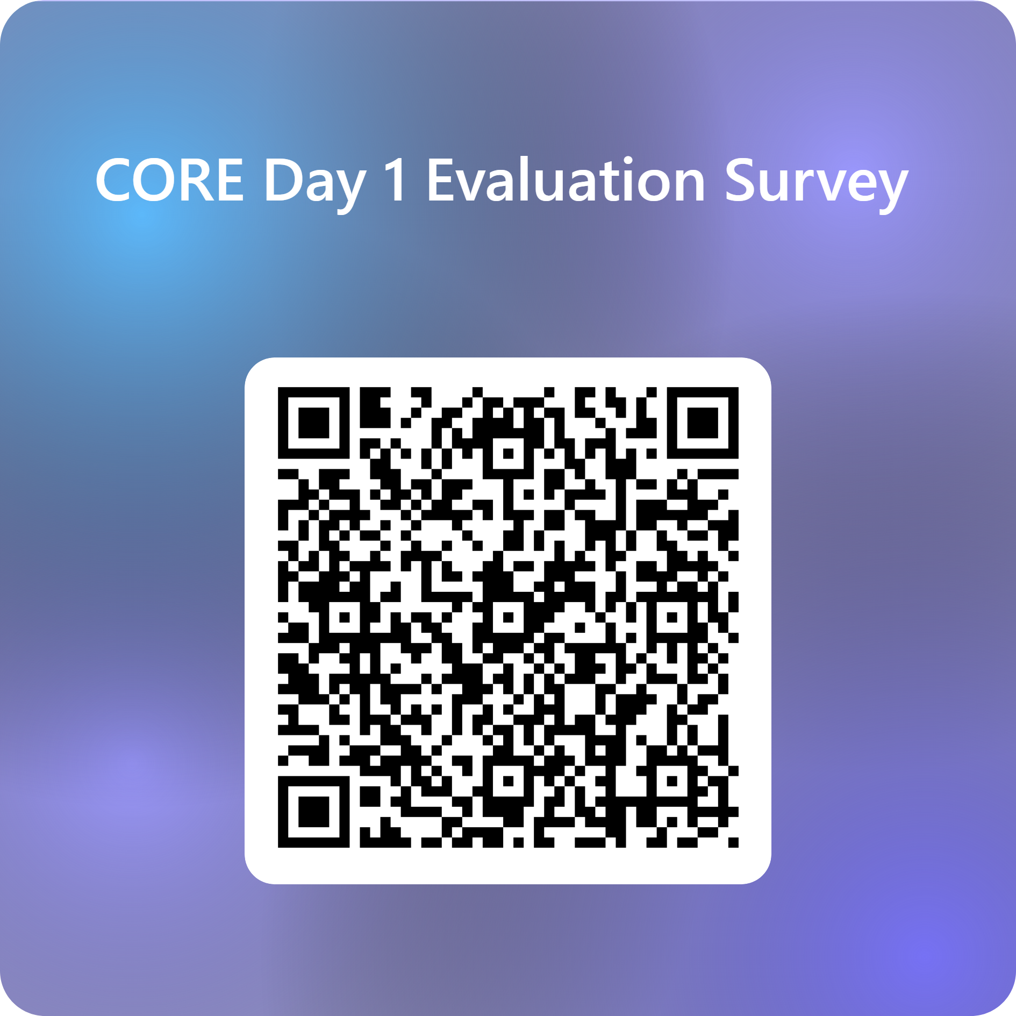
Feedback

Slide 72


Prayer
God of wisdom,
We thank You for all we have explored today
for new learning, for questions, and for moments of insight.
Bless what has been planted in us today.
Give us the courage to keep growing,
the humility to keep learning,
and the grace to keep showing up with love.
As we leave, may we carry the heart of the Gospel into our classrooms:
to see each student as You see them,
to teach with purpose, and to lead with hope.
We ask this in the name of the Father, and of the Son, and of the Holy Spirit.
Amen.
We are a faith-filled learning community creating a better future
Notes:
Susie
God of wisdom,
We thank You for all we have explored today
for new learning, for questions, and for moments of insight.
Bless what has been planted in us today.
Give us the courage to keep growing,
the humility to keep learning,
and the grace to keep showing up with love.
As we leave, may we carry the heart of the Gospel into our classrooms:
to see each student as You see them,
to teach with purpose, and to lead with hope.
We ask this in the name of the Father, and of the Son, and of the Holy Spirit.
Amen.

Slide 73
For more information
Formation and Engagement Services
FES@bne.catholic.edu.au

